Slide 1

Wireless Networking
Ambuj Varshney
ambujv@nus.edu.sg

Slide 2
Wireless and Internet of Things Basics

Slide 3
Roadmap of the lecture today
Let’s Get to Know the Instructors 😊
Course Overview: What is this course about? Logistics and Grading Criteria
Mark Weiser’s Vision for Ubiquitous Computing
Introduction to the Internet of Things (IoT) and Its Growth
History of Wireless Communication
Basics of Antennas and Propagation

Slide 4

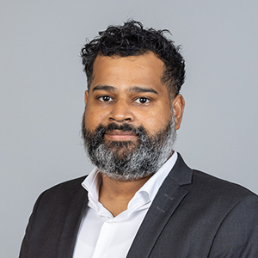
Instructor for the Course
Jingxian Wang
Ambuj Varshney

Slide 5
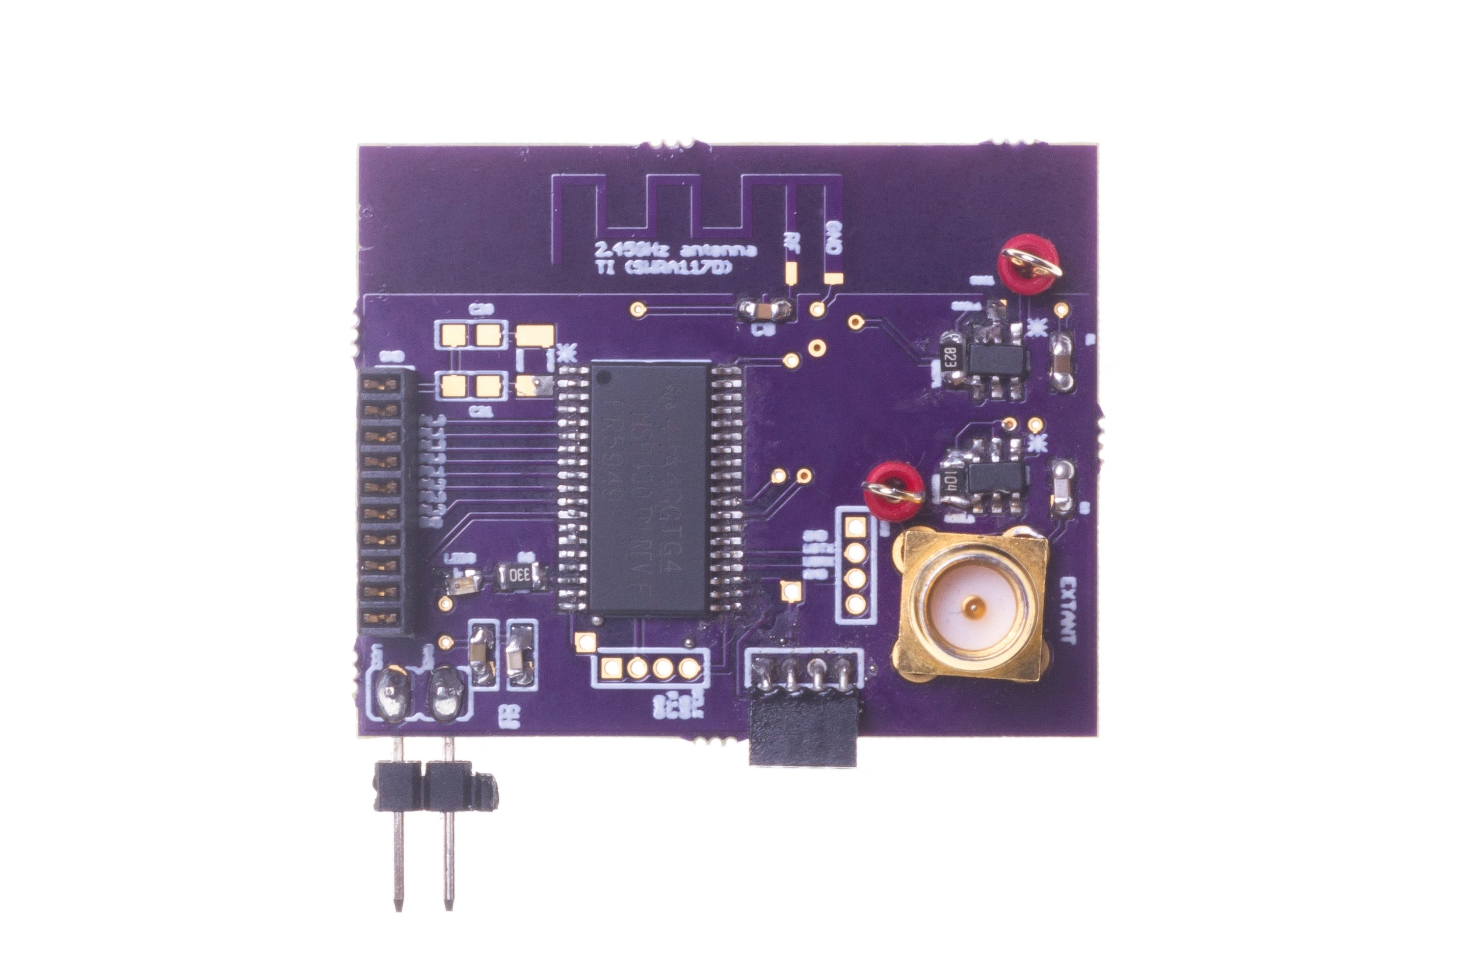
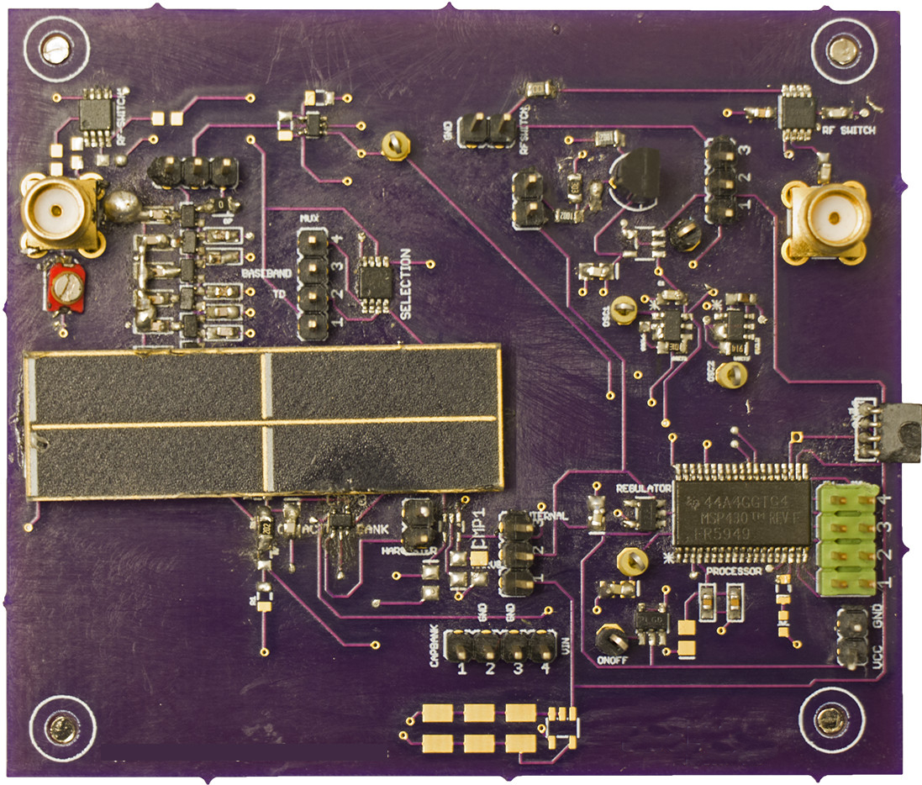
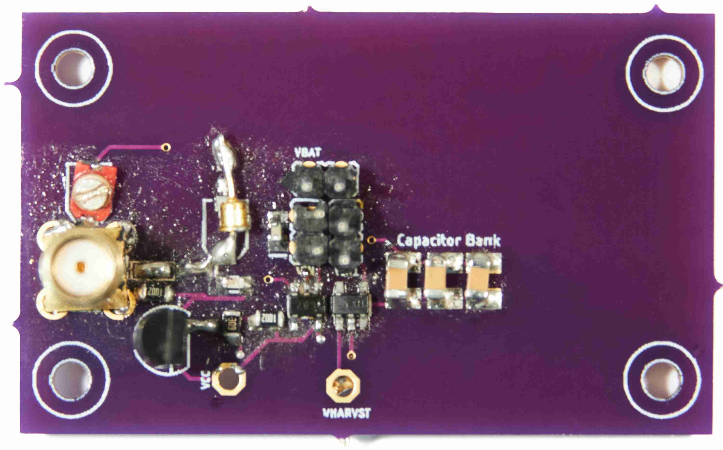
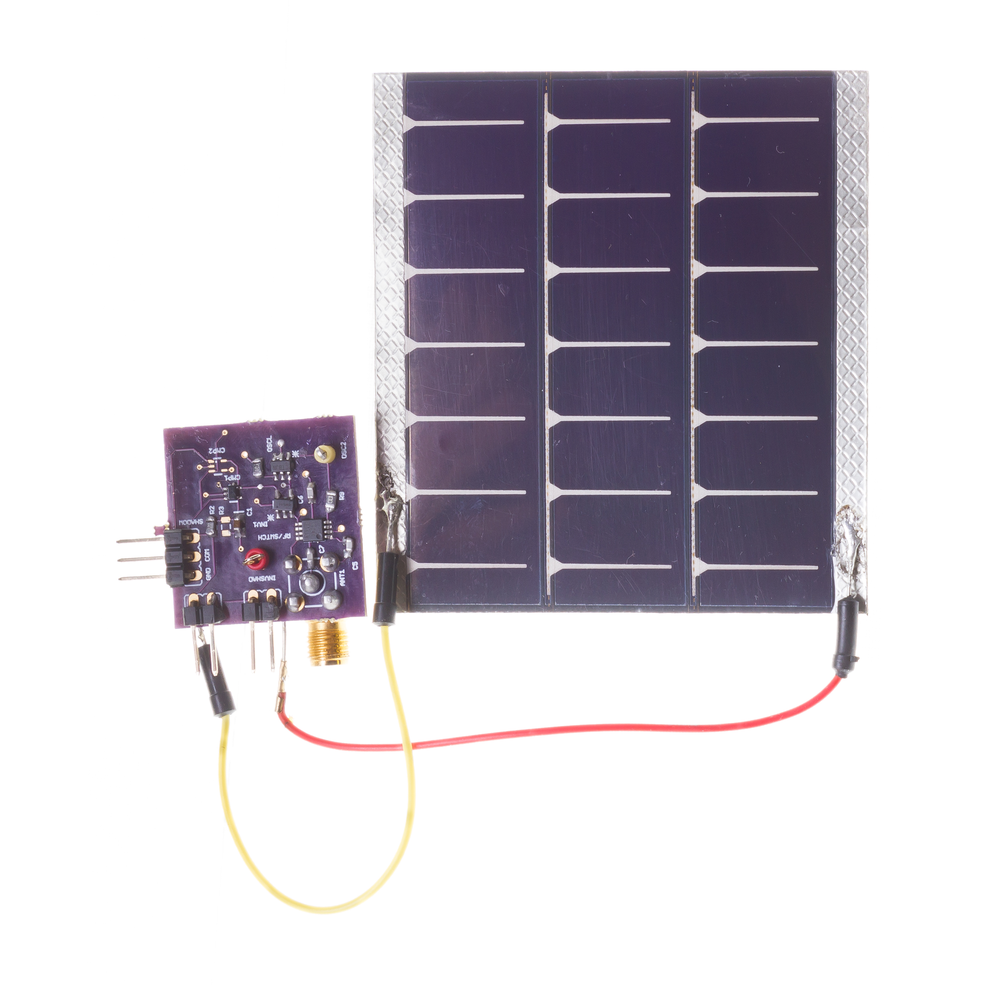
Let us get to know one of the instructor
Build real embedded and wireless systems. Functional prototypes
Wireless embedded systems: Journey started over 15 years back!
Commonly, our work involves designing systems at the intersection of computer science, electrical engineering and computer communication
[ACM SENSYS 2017]
[ACM MOBISYS 2020]
[ACM MOBICOM 2020]
[ACM VLCS 2017]

Slide 6
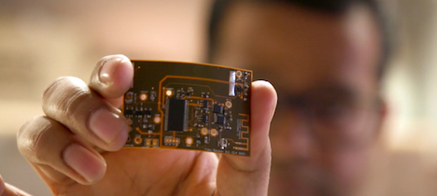


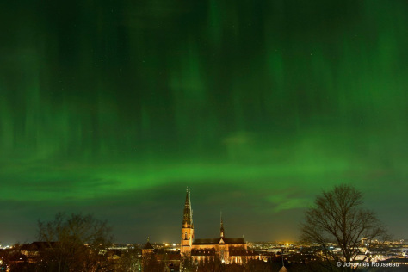

Let us get to know one of the instructor
Doctoral studies conducted in Sweden. PhD from Uppsala University
Dissertation: Enabling sustainable networked embedded systems
Doctoral dissertation awarded 2019 ABB Research Award (Funded Postdoc)
Postdoctoral studies conducted at UC Berkeley
Make sticker computers! STICORS

Slide 7
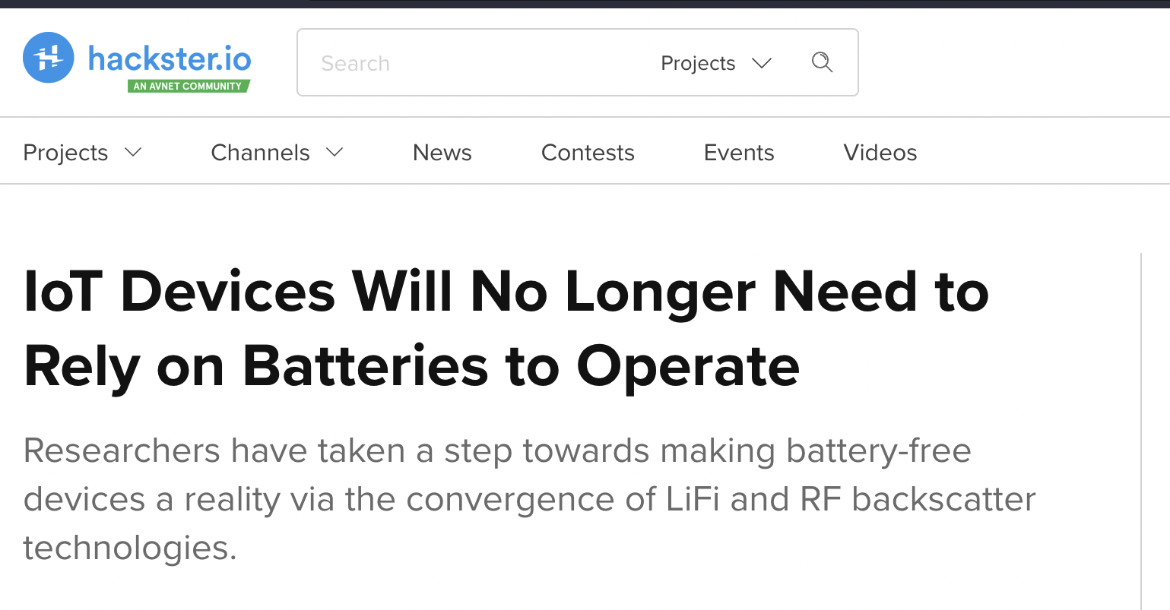

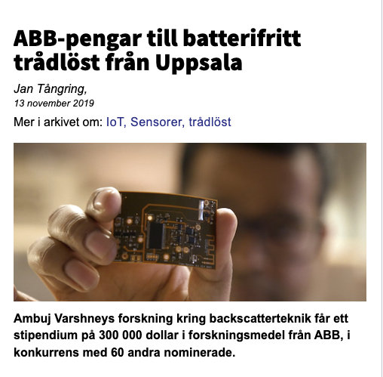
Wireless, Embedded Intelligence, Sensing and Emerging Technologies (WEISER) Group
World leading research in the area of wireless embedded systems
4 PhD students, 1 Postdoc, 1 RA, Many undergraduate and masters students
Regularly publish research findings in flagship venues of the area;
ACM MobiCom, MobiSys, SenSys, Ipsn, Rfid, HotMobile, HotNets, GetMobile, others
Research findings and awards are regularly covered by major media outlets

Slide 8

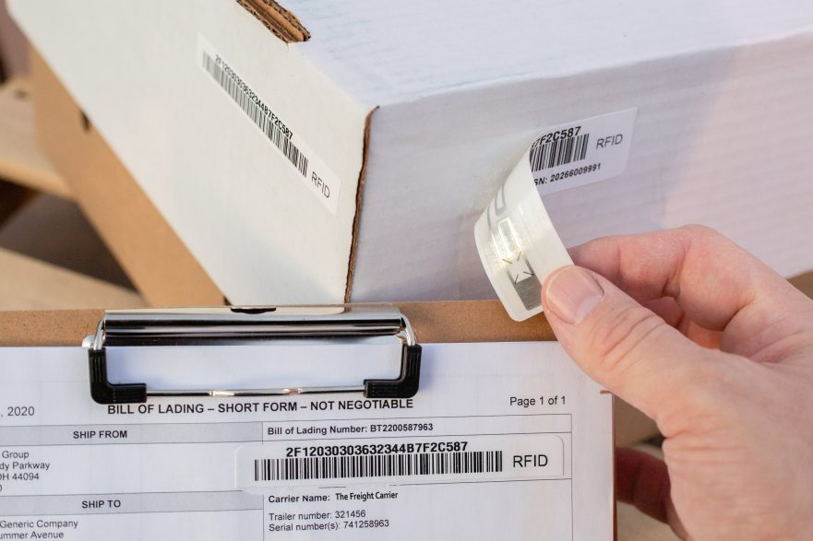
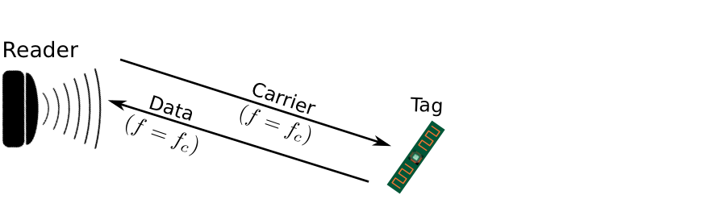
Enabling Sustainable, Large-scale Internet of Things
Internet of Things devices that can operate without batteries!
Breakthroughs to enable zero-power sensing and communication
Sensing and communication operations performed at microwatts of power
100-10,000X lower than state-of-the-art and commercial systems

Slide 9
Long-range Backscatter Transmissions using LoRea
LoRea is a long range, low-power, and low-cost backscatter architecture
System Overview
Backscatter Tag Hardware Prototype
(Peak Power of 70 µW)
Varshney et al. ”LoRea: A Backscatter architecture that achieves a long communication range” ACM SENSYS 2017

Slide 10
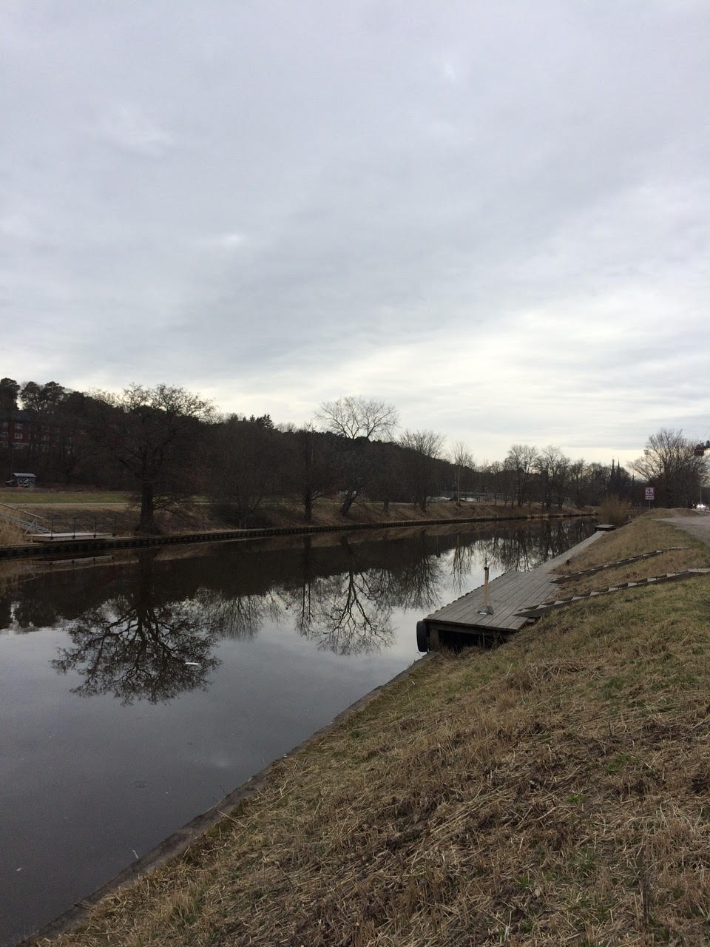
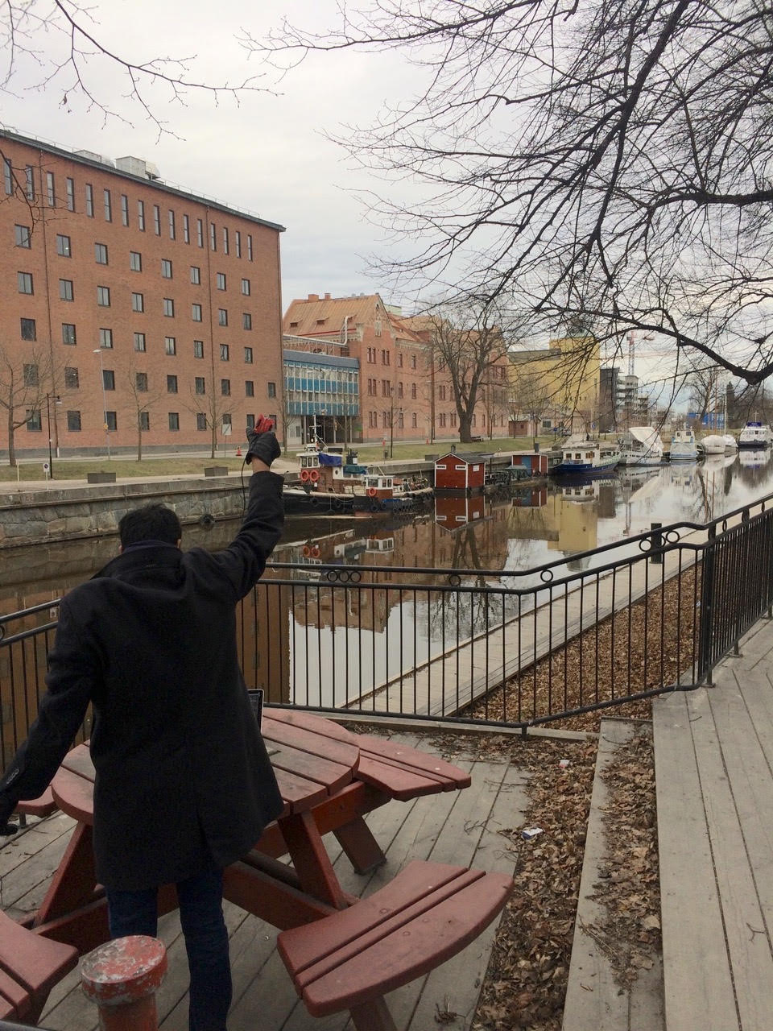
We ran out of space while performing experiments
State-of-art few meters. We achieved kilometers, was difficult to anticipate
Initial experiments conducted near the university and a river in Uppsala
Experiment Setup
Receiving transmissions 1km away from the setup

Slide 11
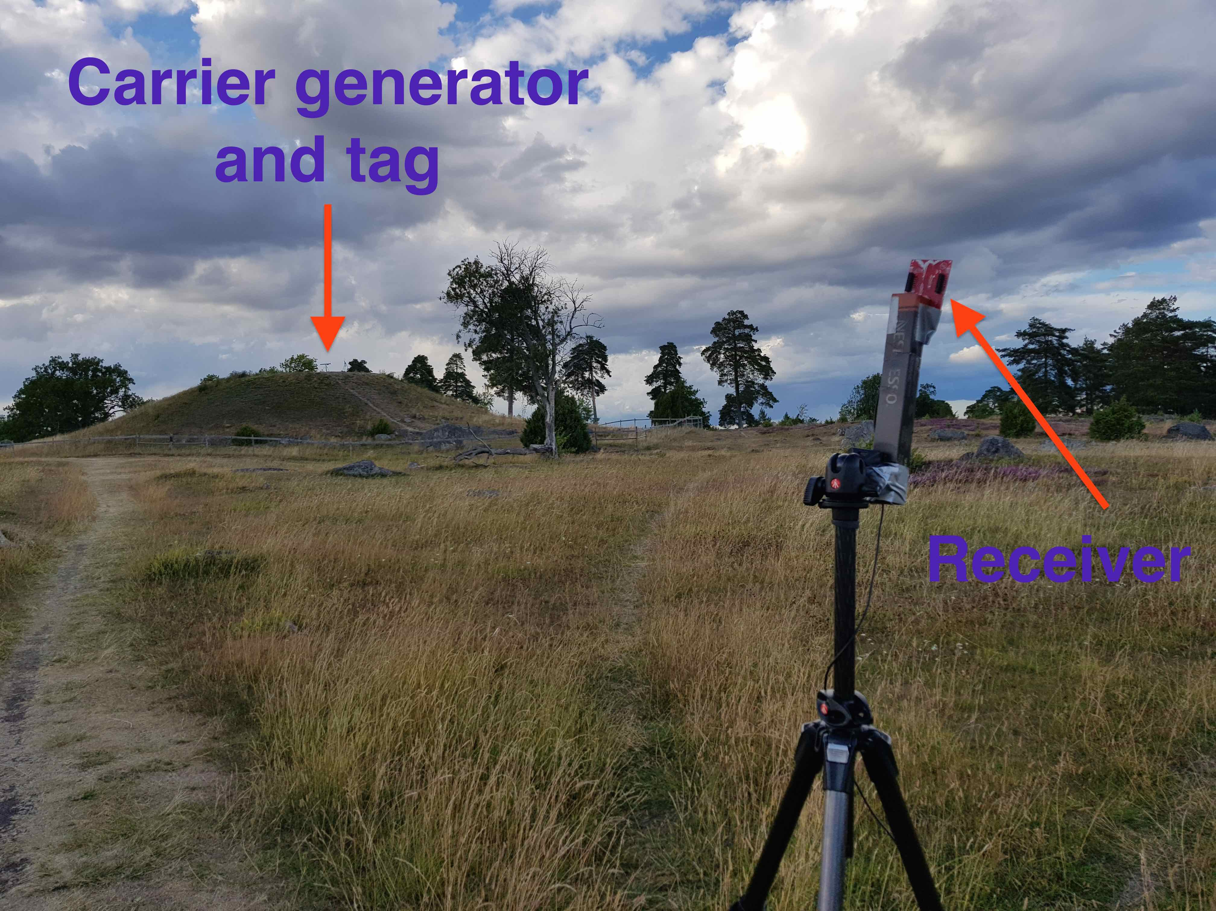
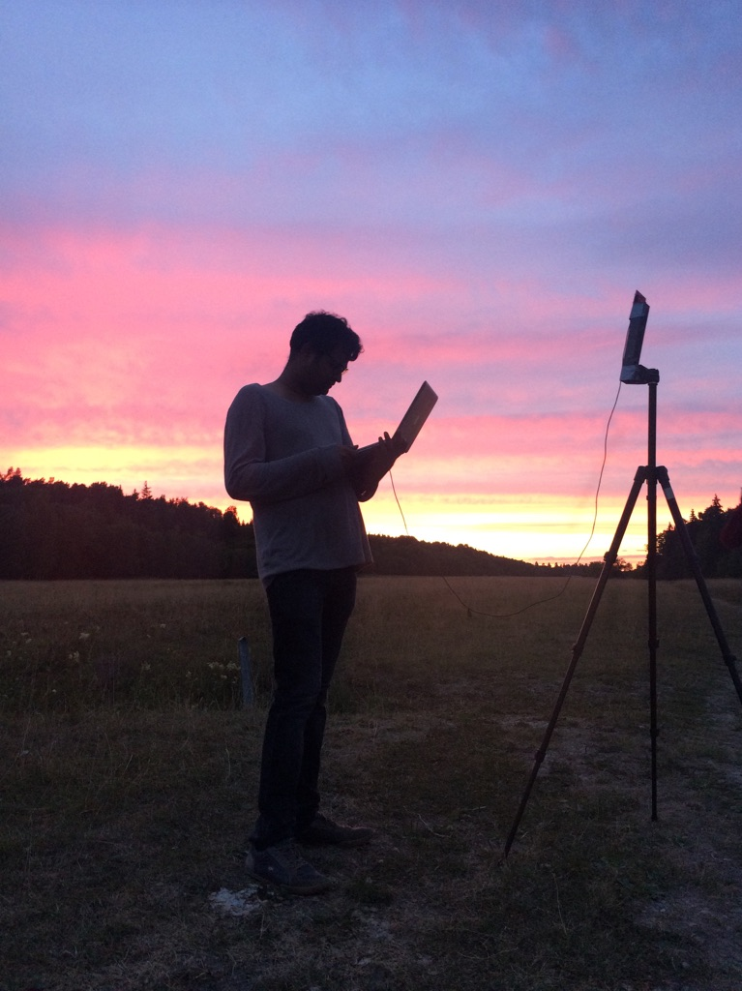

LoRea achieved the highest demonstrated range
Receive up to a distance of 3.4 kilometers from tag
Highest demonstrated range. Outperforms leading labs/universities
Experiment Setup
(On a small hill)
Receiving backscatter transmissions kilometers away from setup
Experiment setup video

Slide 12
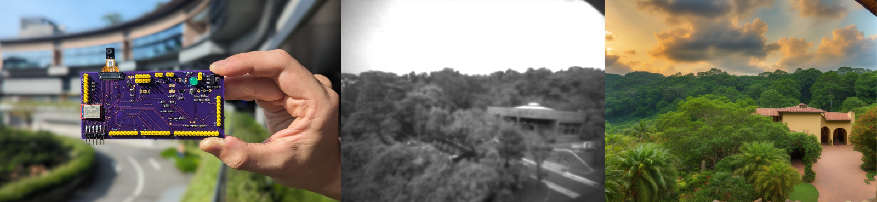
Rethinking Embedded Camera Systems
Intersection of Image/Language models with embedded systems
Low-power hardware, generate a rich representations of the world
Applications: Extended Reality! And many more!
Li et al. “PixelGen: Rethinking Embedded Cameras for Mixed-Reality” ACM Immercom 24, Best Demo (Runner-up) at the ACM/IEEE IPSN 2024

Slide 13
Roadmap of the lecture today
Let’s Get to Know the Instructors 😊
Course Overview: What is this course about? Logistics, Grading Criteria
Mark Weiser’s Vision for Ubiquitous Computing
Introduction to the Internet of Things (IoT) and Its Growth
History of Wireless Communication
Basics of Antennas and Propagation

Slide 14
Course Information
Notes:
++ Over the past few years, I have designed several backscatter and beyond backscatter systems that precisely overcome these critical challenges that have limited the widespread deployment of backscatter on IoT devices.
++ The research vision that I have pursued and would like to pursue as a faculty member is to enable a massive deployment of IoT devices by bridging the energy asymmetry between sensing, computation and communication blocks by designing novel platforms and communication mechanisms. I am going to describe some of my research contributions next.

Slide 15
General information regarding the course
Course code: 4222/5422, Day of week: Tuesday, 6:30 to 8:30 pm (Lectures)
Tutorials: Starting Next Week! Eight slots
Office hours: COM3 - #2 – 25
Please send me an email to reserve slot
What can you discuss? Anything ☺

Slide 16
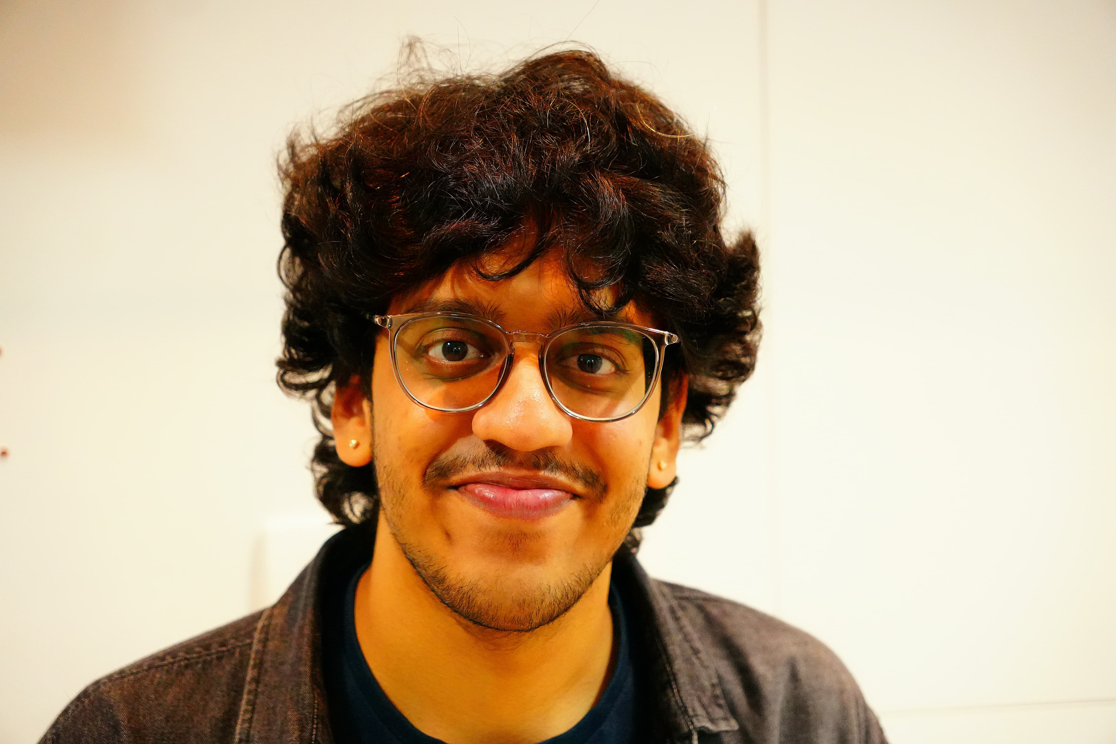


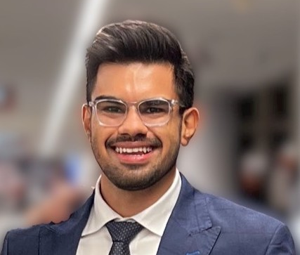

Brilliant teaching assistants of the course
Tutorials: They are starting next week!
Kanav Sabharwal (PhD Student)
Rajashekar Chinthalapani (PhD Student)
Pramuka Medaranga (PhD Student)
Viswanadh Kandala (PhD Student)
Dhairya Shah (PhD Student)

Slide 17
Course webpage and lecture recordings
Course webpage: Canvas
Canvas: It will be used for submission of project/assignment
Discord: A forum for discussions. Will be enabled soon
Look out for emails with subject (CS4222) for the announcements
How about lecture videos?
The recorded videos will be made available on the canvas
Last two years lecture video are already linked to the course page
Caution: Some parts of the course have undergone change. Prior years lecture may cover additional material or material not planned this year

Slide 18
What is this course all about?

Slide 19
CS4222: What is this course about?
This course provides an introduction to wireless networking. It covers the fundamental concepts, including signal propagation, modulation, and energy consumption estimation. Building upon these foundational topics, the course explores various layers of the wireless networking stack, including physical, MAC, networking and application layers. These lead to case studies covering commodity wireless standards (like WiFi, Bluetooth), Cellular networks, and the Internet of Things (IoT). Throughout the course, students will participate in tutorials, assignments and hands-on projects, enabling them to apply concepts and develop software prototypes for real IoT devices, thus translating the knowledge acquired into practical scenarios.

Slide 20
How would the student’s performance be graded
Component | Weightage to Overall Grade
Project (group) | 20 %
Assignment 1 (group) | 5 %
Assignment 2 (group) | 10 %
Assignment 3 (group) | 10 %
Tutorial | 10 %
Pop Attendance/Quiz/Floating | 5 %
Final assessment | 40 %

Slide 21
Assignments and Course Project
Enables students to learn programming and applying concepts related to wireless networking on embedded systems. We will release details of assignments and projects at the end of Week3 (end of first tutorial week)
Assignments has to be done in a group. Please start forming group (upto 4)
Caution: CS4222 students CANNOT group with CS5422
We will ask for individual contribution statement at the end of course

Slide 22
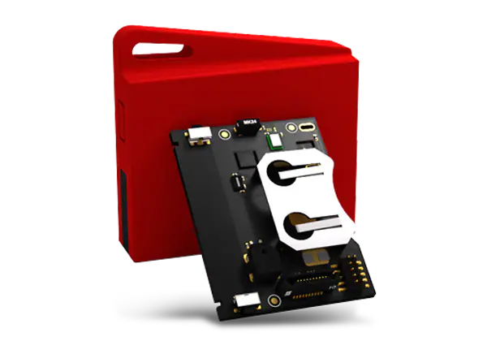
Device to be used for Assignment and Project
Sensor tag and Programmer: A wireless embedded device
Look for email for information regarding collection of sensortags
We can give 2-3 sensor tags per group
The sensor tags would allow us to conduct wireless experiments
Can run on a coin cell battery for weeks to months!
We will be use Contiki OS for programming sensor tag devices
Developed at SICS (Swedish Institute of Computer Science) now RI.SE

Slide 23
Tutorials
First two tutorials are already uploaded on the course webpage
Attendance to tutorials is graded (10% of overall grade)
Expectation: Read questions before coming to the session. Solve and ask doubts from the teaching assistants
Very important as you can expect questions in the final assessment to be very similar to the ones you will find in the tutorials
Tutorials: Begin Week3! Please attend tutorials in designated slots
Exception: can attend other slots, please ask TA’s to note down your details

Slide 24
Roadmap of the lecture today
Let’s Get to Know the Instructors 😊
Course Overview: What is this course about? Logistics and Grading Criteria
Mark Weiser’s Vision for Ubiquitous Computing
Introduction to the Internet of Things (IoT) and Its Growth
History of Wireless Communication
Basics of Antennas and Propagation

Slide 25
Mark Weiser Vision for Ubiquitious Computing

Slide 26
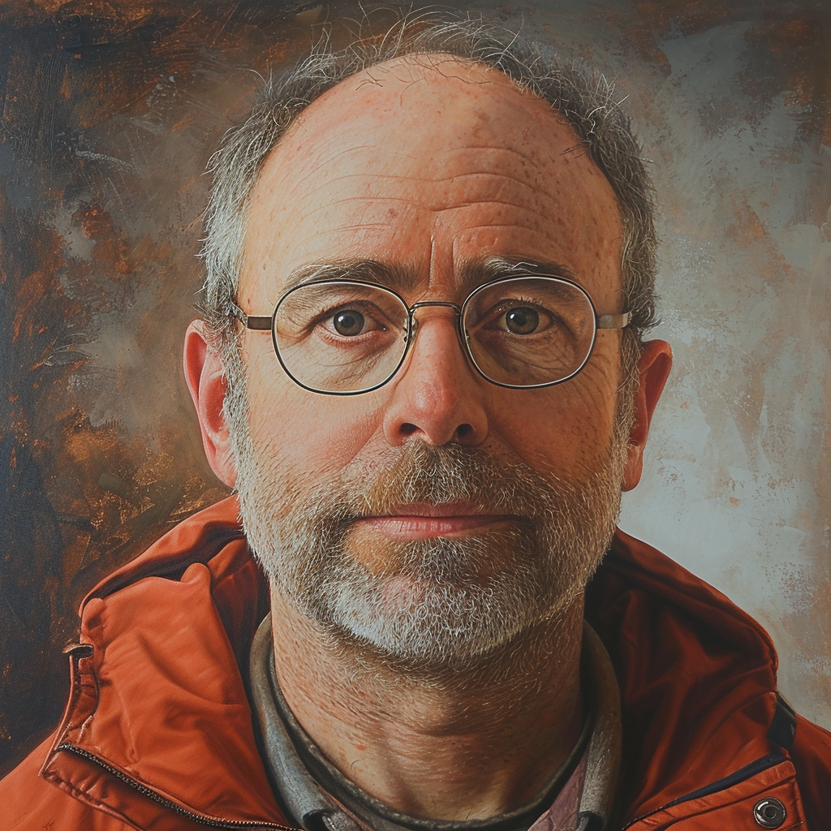
Mark Weiser vision of ubiquitous computing
Mark Weiser (1952 – 1999)
PhD (University of Michigan), CTO at Xerox PARC
Considered “Father” of ubiquitous computing
He is a highly influential figure in the area
What is ubiquitous computing?

Slide 27
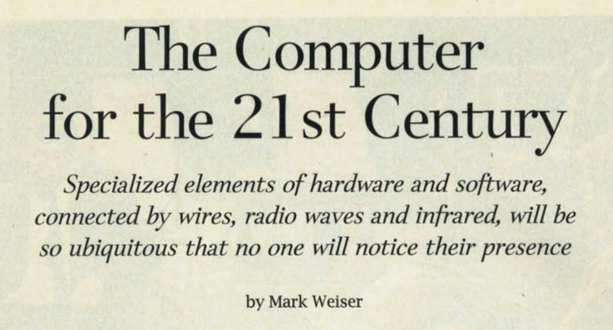
Mark Weiser vision of ubiquitous computing
The Computer for the 21st Century, Scientific American, 1991

Slide 28
Mark Weiser vision of ubiquitous computing
Hypothesis of the article: Advances in technology (low power, new wireless communication, new interfaces) will enable “invisible computing”, which will enhance human capability …

Slide 29
Mark Weiser vision of ubiquitous computing
“The most profound technologies are those that disappear”
”Products…that do not require active attention”
“Whenever people learn something sufficiently well, they cease to be aware of it”
“[Computers will become invisible and] people will simply use them unconsciously to accomplish everyday tasks”
“[R]ather than being a tool through which we work, and thus disappearing from our awareness, the computer too often remains the focus of attention”
“Applications are of course the whole point of ubiquitous computing”

Slide 30

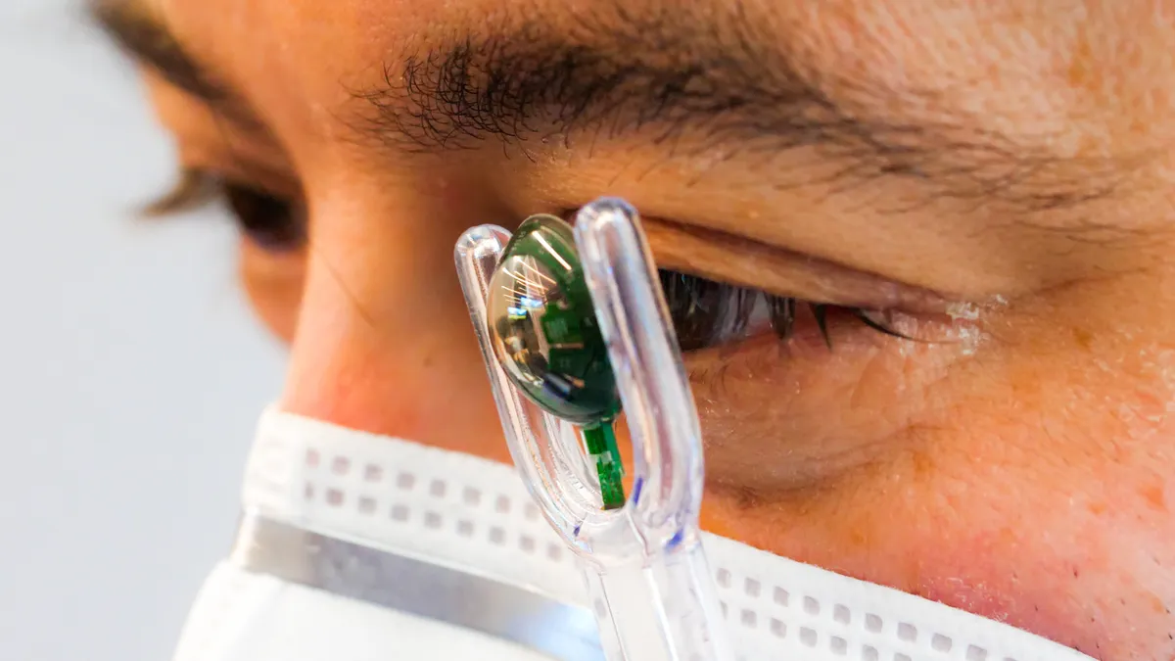
Mark Weiser vision of ubiquitous computing
What are upcoming technologies that may become ubiquitous?

Slide 31
Roadmap of the lecture today
Let’s Get to Know the Instructors 😊
Course Overview: What is this course about? Logistics and Grading Criteria
Mark Weiser’s Vision for Ubiquitous Computing
Introduction to the Internet of Things (IoT) and Its Growth
History of Wireless Communication
Basics of Antennas and Propagation

Slide 32
Do you know what the Internet of Things is? How does Internet of Things impact you?
Notes:
++ Over the past few years, I have designed several backscatter and beyond backscatter systems that precisely overcome these critical challenges that have limited the widespread deployment of backscatter on IoT devices.
++ The research vision that I have pursued and would like to pursue as a faculty member is to enable a massive deployment of IoT devices by bridging the energy asymmetry between sensing, computation and communication blocks by designing novel platforms and communication mechanisms. I am going to describe some of my research contributions next.

Slide 33
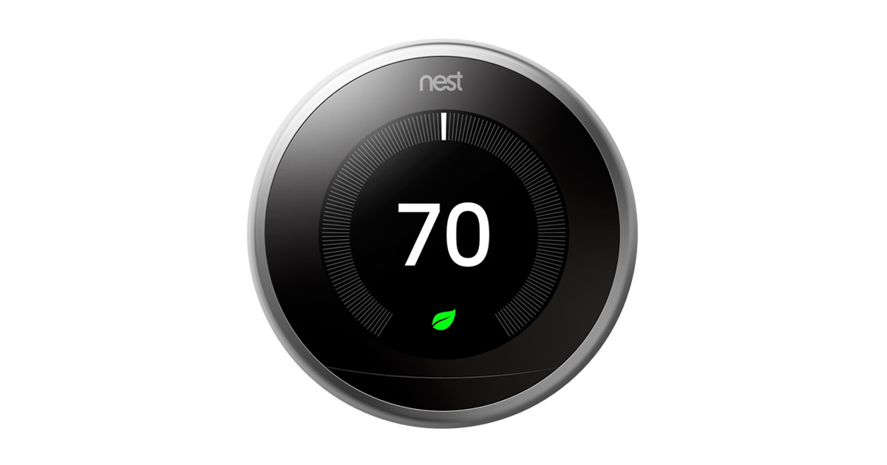
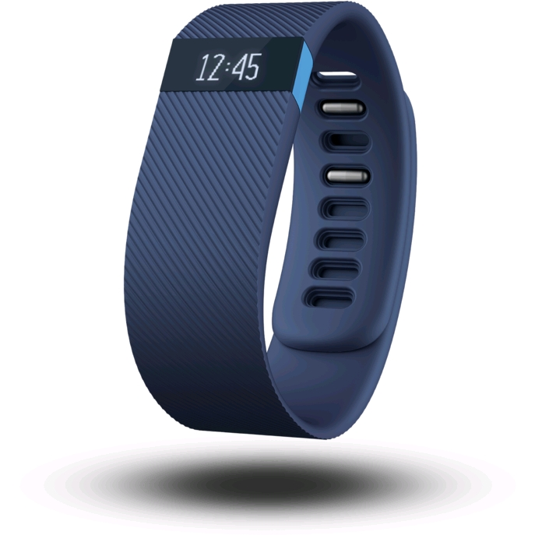
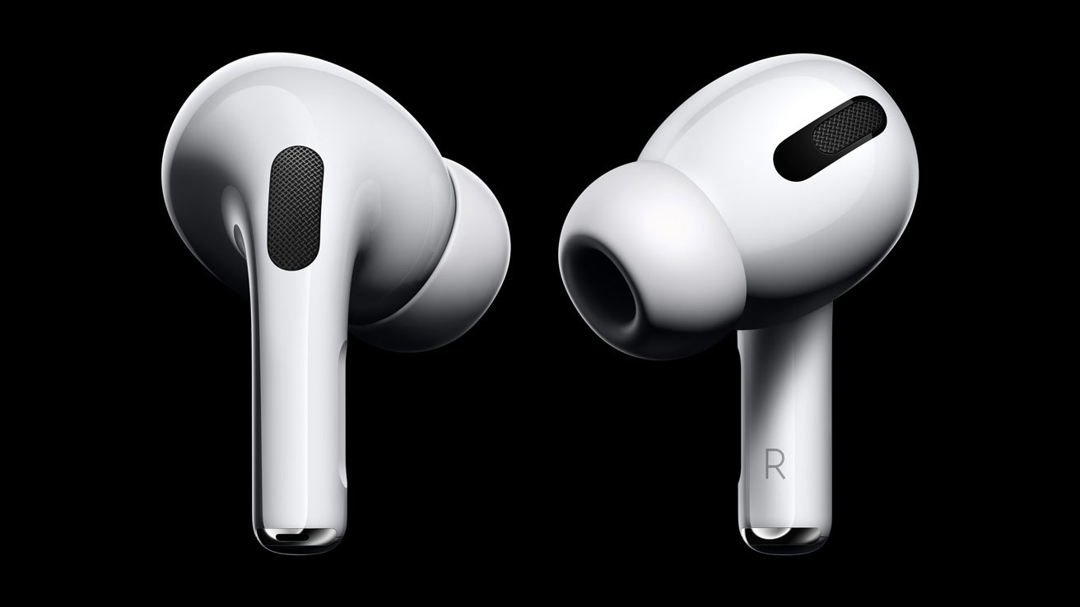
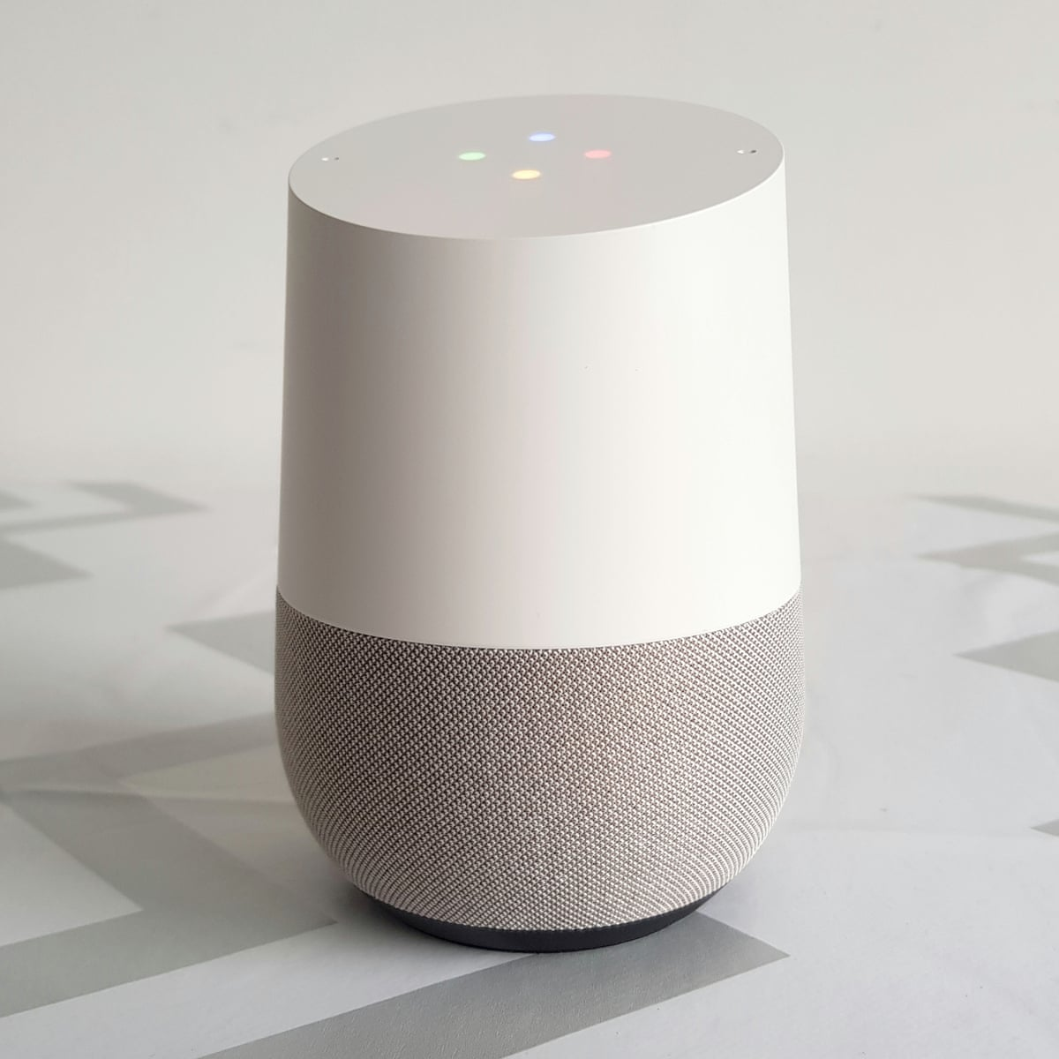
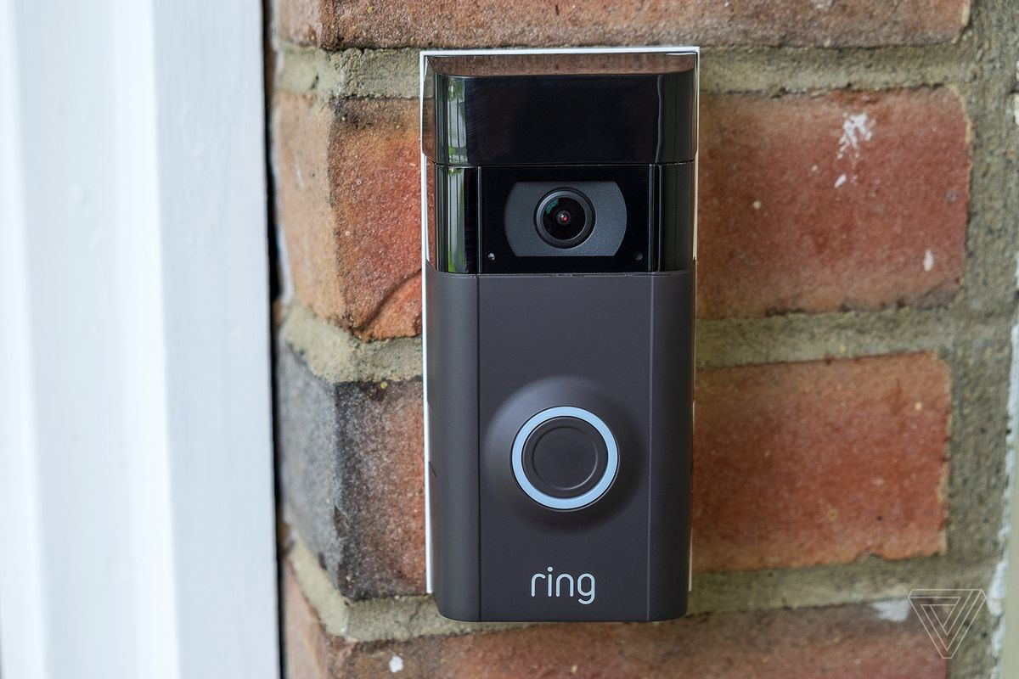
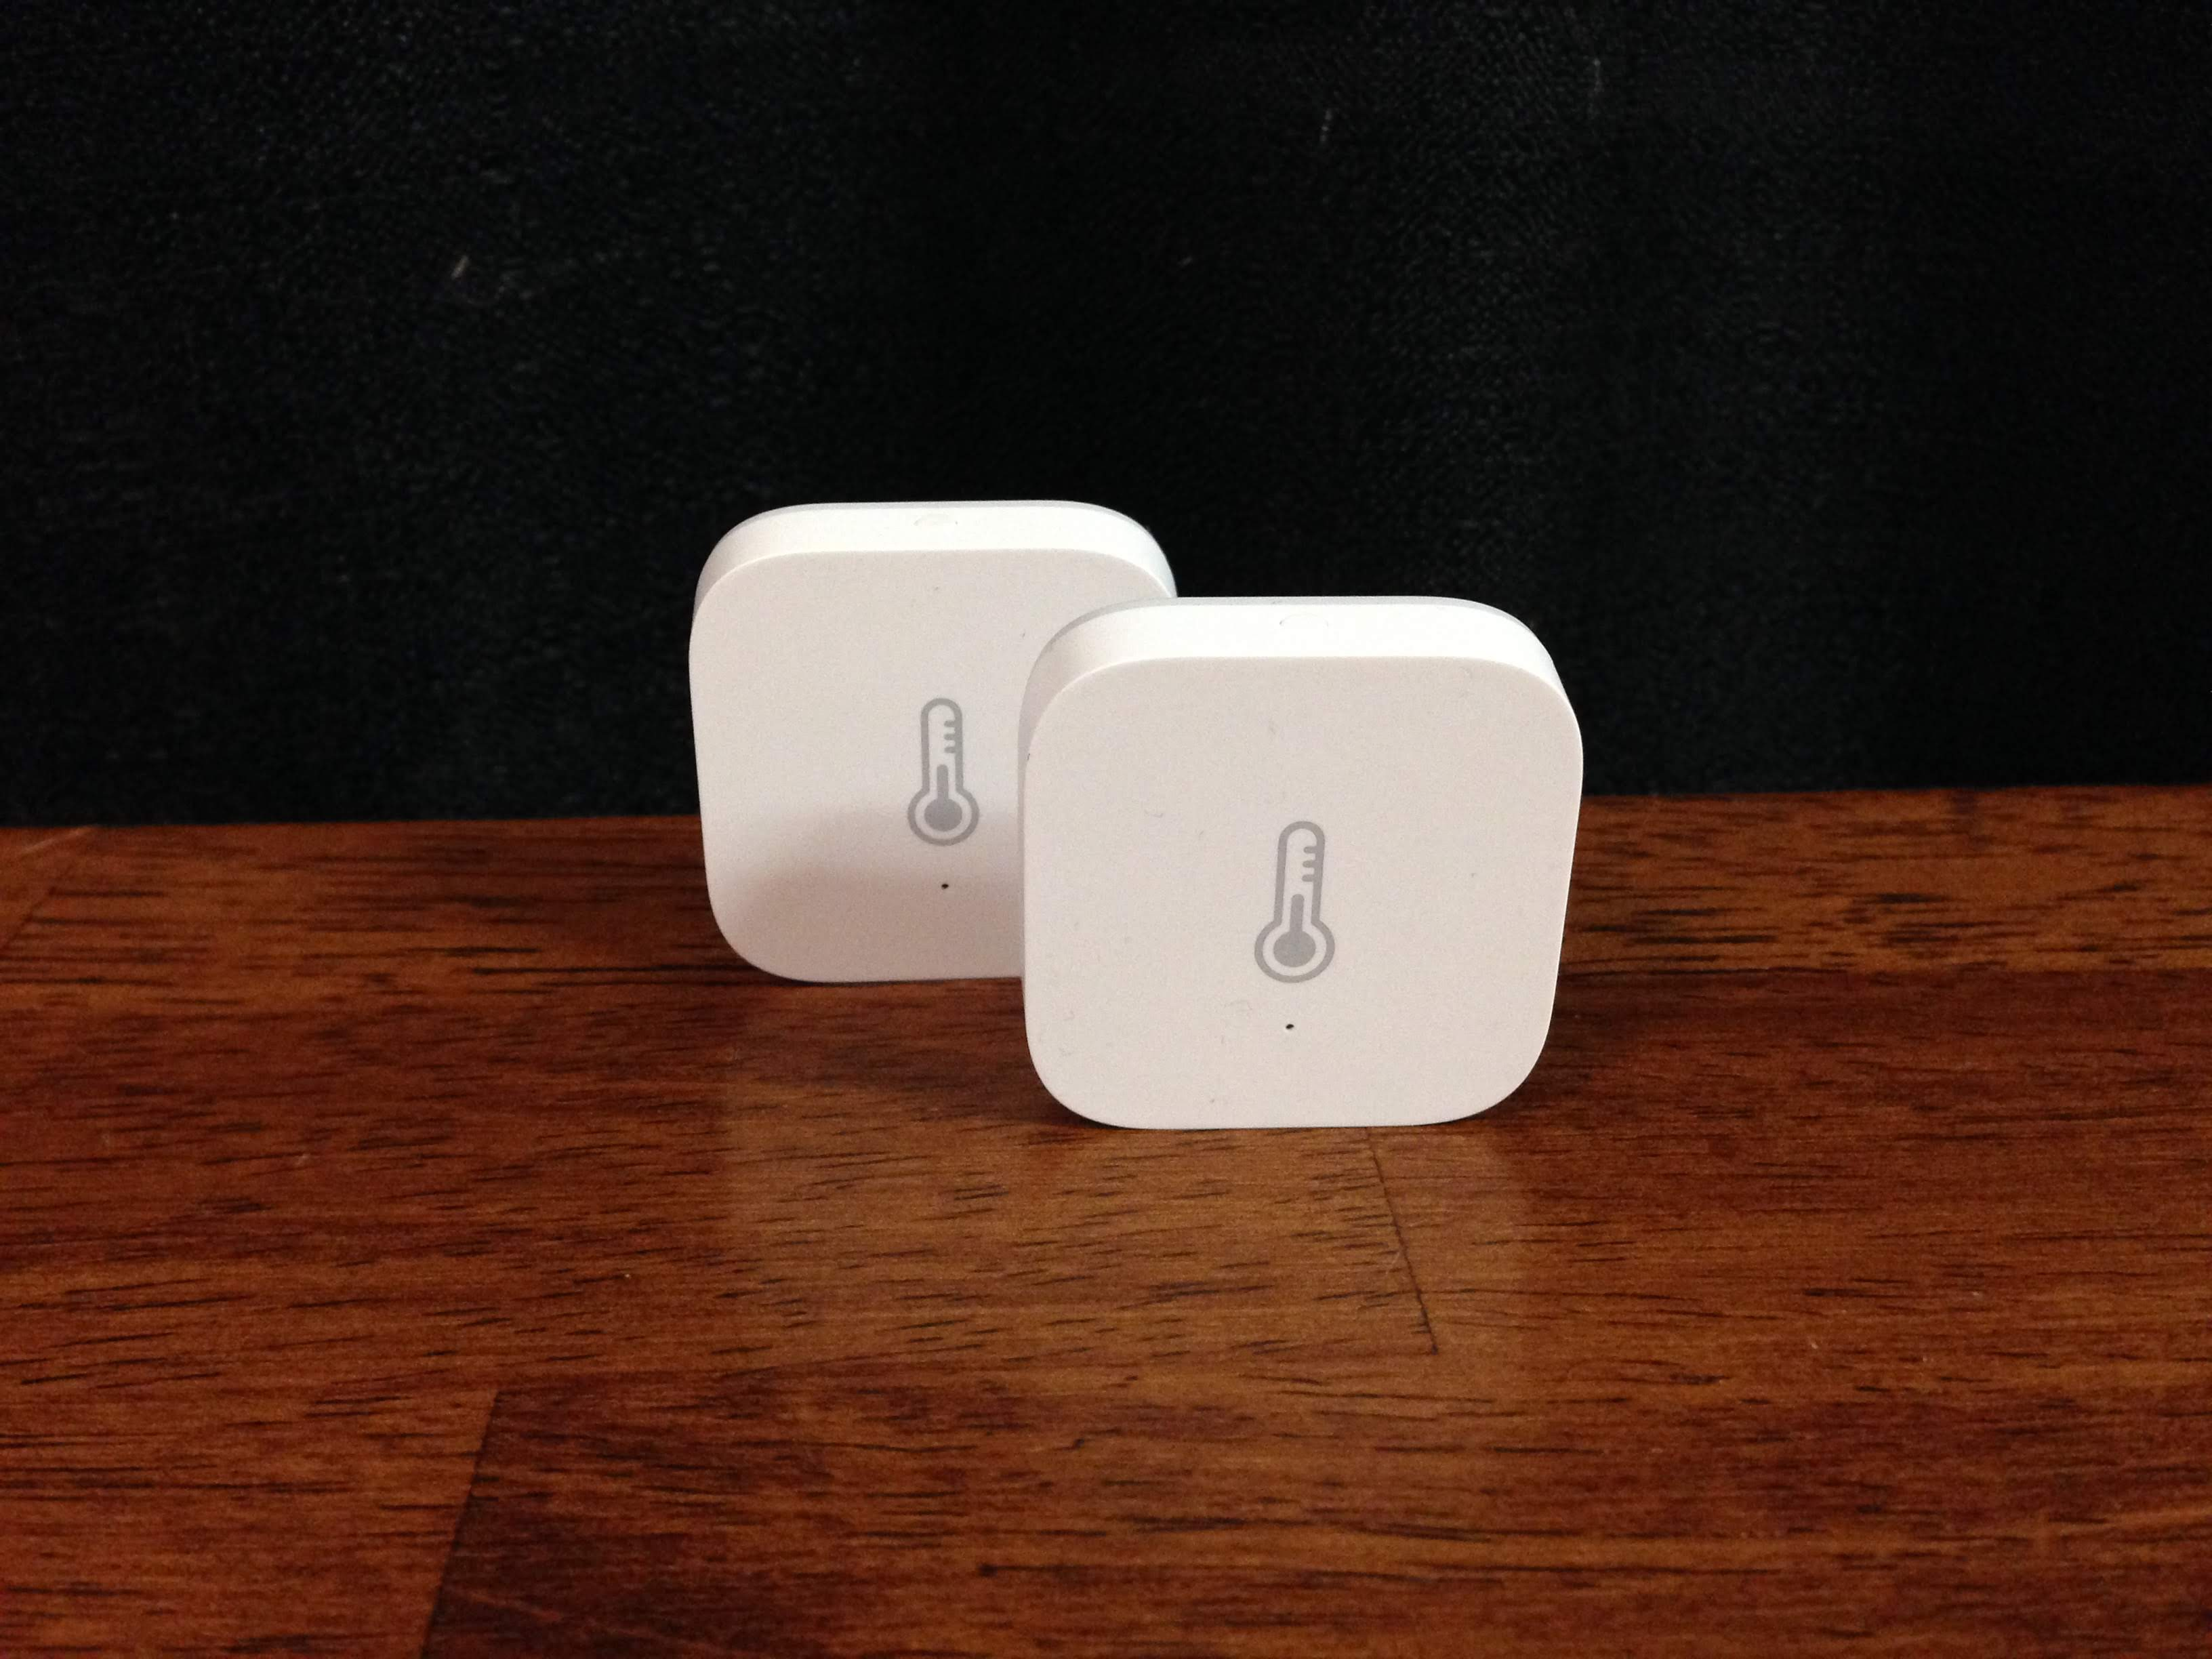
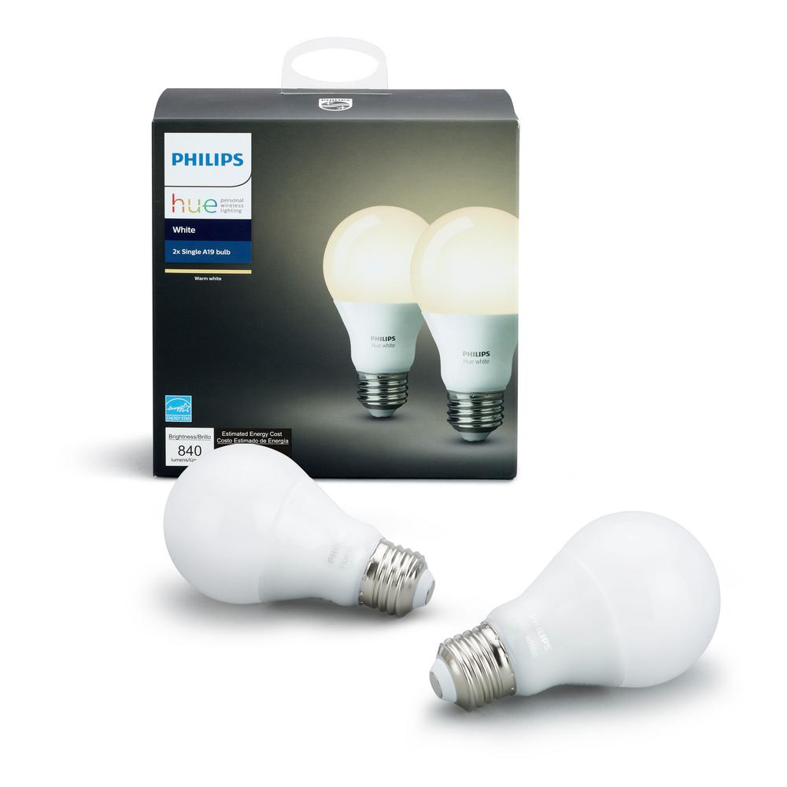
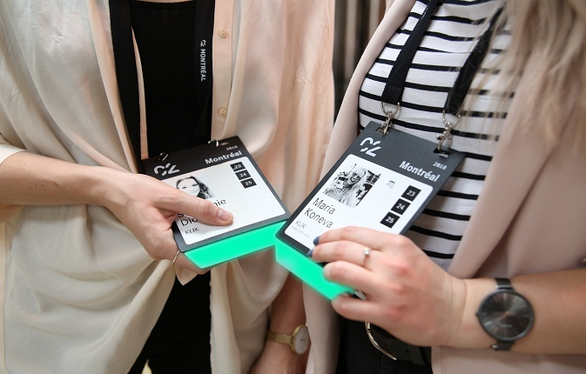
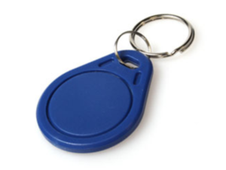
Internet of things devices are all around us...
Google nest thermostat
Fitbit activity tracker
Apple airpods
Smart speaker
Ring doorbell
Xiaomi temperature sensor
Philips hue smart bulb
Smart badges
BLE proximity beacon
Notes:
+ I begin this presentation by demonstrating devices that we interact with within our daily lives. These include Fitbit, AirPods, smart speakers or ble proximity beacons that we attach to objects such as keychain to keep track of them. All of these are examples of wireless embedded systems.

Slide 34
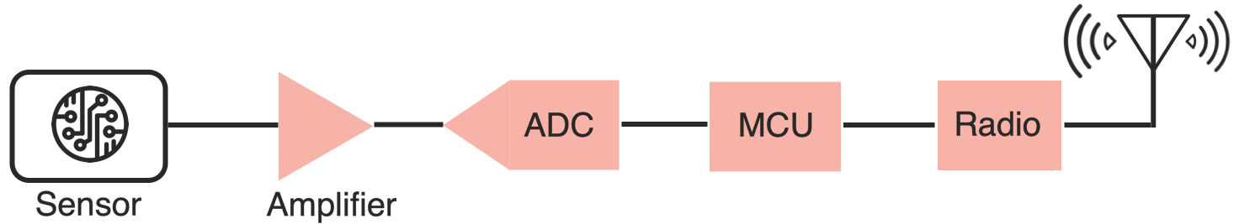
Wireless embedded devices architecture
During past decades, sensors and come become energy-efficient
E.g., Accelerometer, Temperature, Image Sensors: Few µW’s of power
Energy asymmetry exists between the sensors, computational elements and radio transceivers
Conventional and widely used architecture of embedded wireless platform
Notes:
Why do the IoT platforms suffer from this energy challenge? To understand this, we investigate the architecture of the IoT device. We show this architecture in the figure on the slide. It consists of a series of stages that enable us to sense physical phenomena, process and transmit the sensor information through a transceiver such as ZigBee/BLE/LoRa.
This architecture has remained unchanged over the past two decades. We find that during this time, sensors have become exceeding efficient. Today, we find sensors such as an accelerometer or a temperature sensor consumes just a few tens of microwatts of power consumption. However, we find that rest of the architecture components that are shown in red colour remain significantly energy expensive. To understand the reason for this significant energy asymmetry, we look at the following slide.

Slide 35
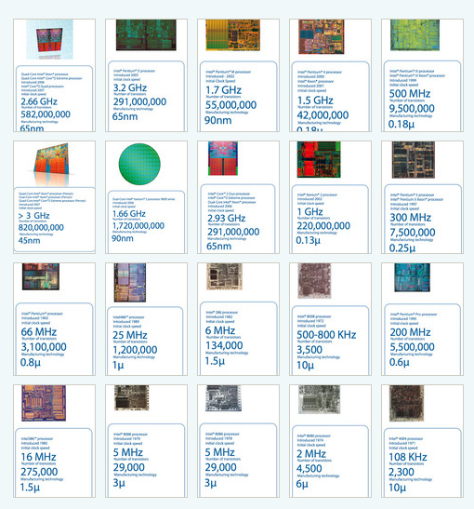
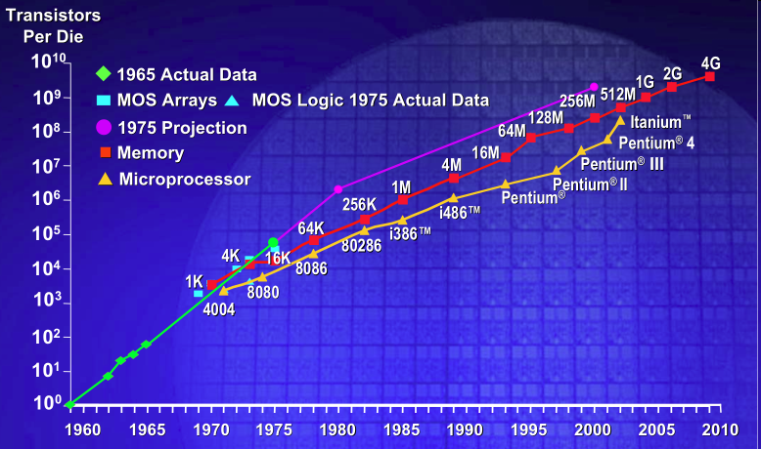
IC transistor count doubles every two years
Photo Credit: Intel
Notes:
So if we look at the computing spectrum today, each of the classes exist simultaneously. In a room we can put 100s of teraflops and many petabytes of computing.
Our productivity, document preparation, and personal information management fits in our pocket and a new class is emerging that will provide a means of streaming information to and from the physical world like we have never seen before.

Slide 36
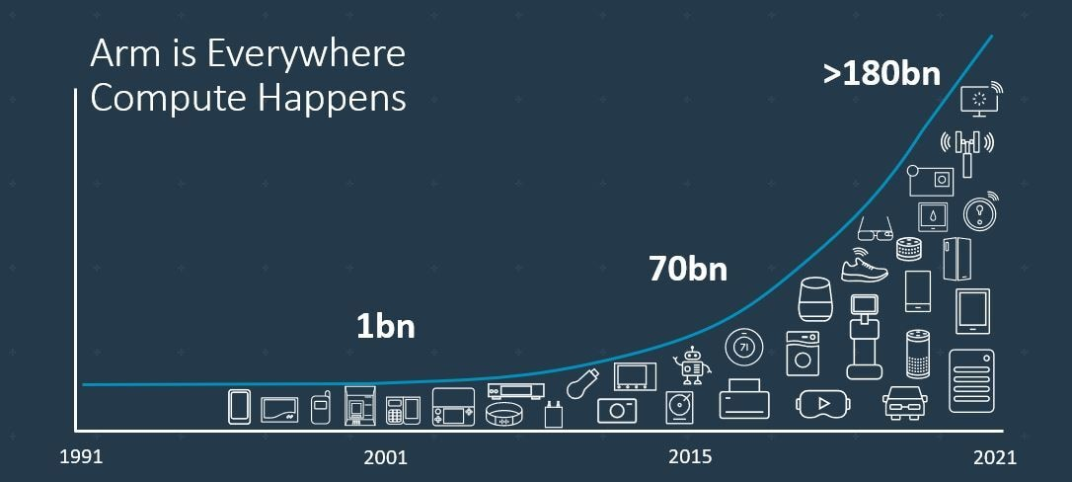
Trillion embedded devices will be deployed soon
Fourth quarter of 2020. Arm shipped 4.4 billion Cortex-M processors
ARM Press Release (Feb 11, 2021) reporting on Fourth Quarter 2020
Notes:
++ Due to the numerous applications that the internet of things enables, we are witnessing a massive growth in the number of microcontrollers being sold. These microcontrollers form the heart of the IoT platforms.
++ To illustrate this point: ARM, a popular UK based company, just reported numbers, and in these numbers, they state that they sold 4.4 billion cortex M processors in just one quarter. These microcontrollers are almost exclusively used on IoT platforms, which demonstrates the massive growth we are witnessing in the number of deployed IoT devices.
++ If this growth continues, and in fact, I believe this growth will accelerate, we will soon have a trillion embedded devices that are going to be deployed in the world.

Slide 37
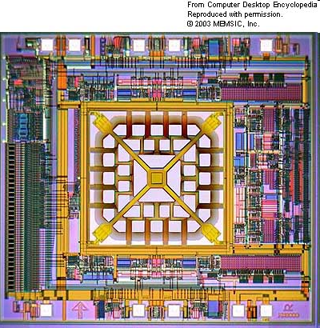
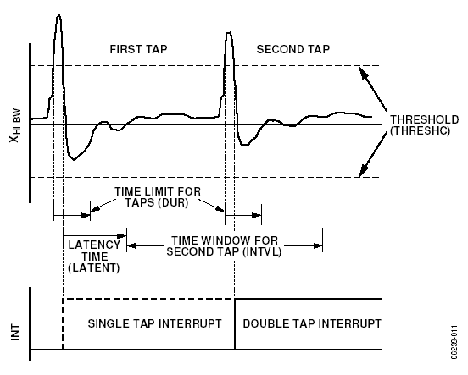
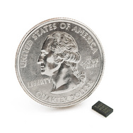
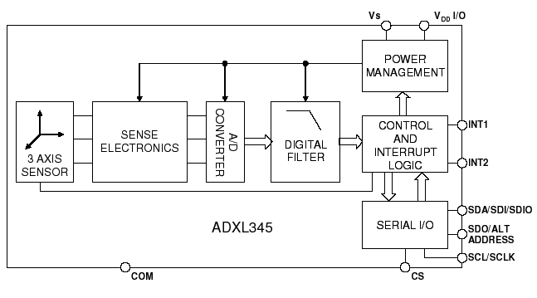
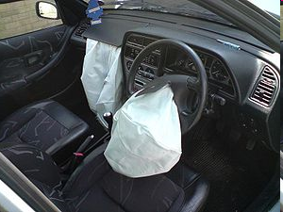
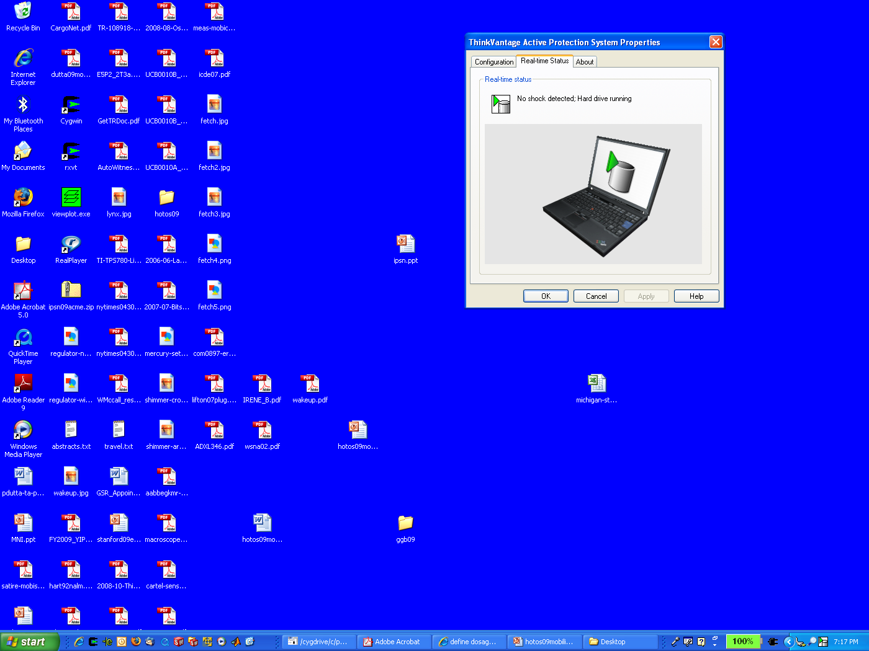
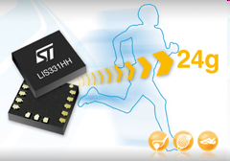
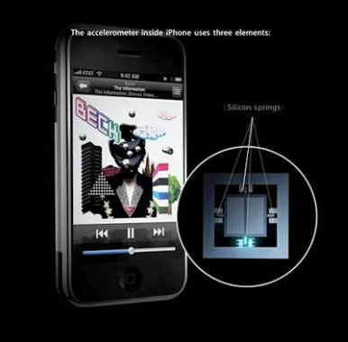
MEMS Accelerometers: Rapidly falling price and power
O(mA)
Price
Power
25 µA @ 25 Hz
ADXL345
[Analog Devices, 2009]
10 µA @ 10 Hz @ 6 bits
[ST Microelectronics, annc. 2009]

Slide 38
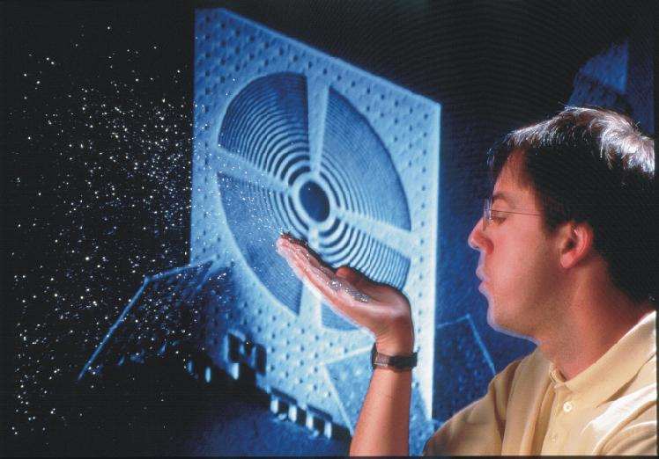
Smart dust: Computers in the form of a dust
K. Pister, UC Berkeley, Smartdust

Slide 39
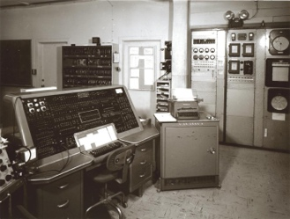
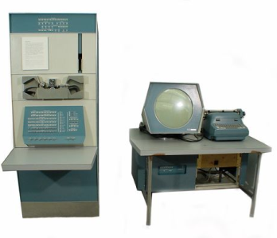
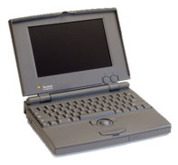
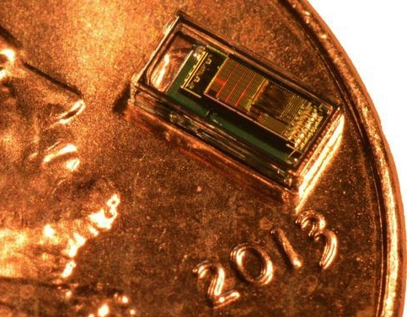
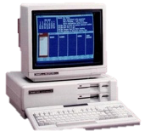

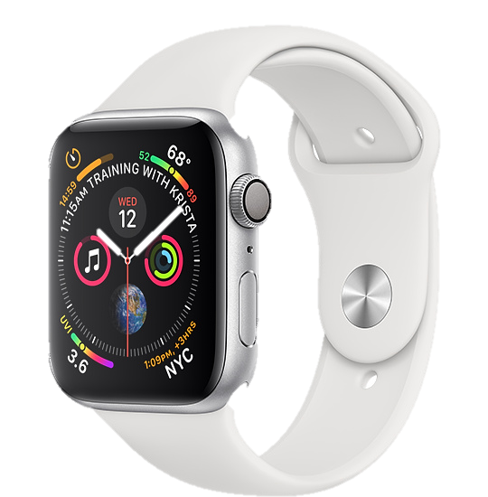
Trillion embedded devices will be deployed soon
Mainframe
“Roughly every decade a new, lower priced computer class forms based on a new programming platform, network, and interface resulting in new usage and the establishment of a new industry.”
1 per Enterprise
Workstation
1 per Engineer
[Bell et al. Computer, 1972, ACM, 2008]
Smart Dust
Laptop
100 – 1000’s per person
log (people per computer)
1 per Professional
IoT/Wearable
Mini Computer
10’s per person
1 per Company
Personal Computer
1 per Family
Smartphone
1 per person

Slide 40



Where are we right now?

Slide 41









Four main tasks performed by an embedded device
Computation and Storage
Sensing and Actuation
Power
Management
Wireless Networking
Notes:
First, we look at the computational elements, and these consist of a microcontroller or an FPGA. Today, we find that these computational elements consume at least one order of magnitude higher power consumption when compared to the commonly used sensors.
However, we also find that microcontrollers are increasingly becoming energy efficient. We investigate a typical microcontroller that has been used in sensor platforms over the past two decades. We find that energy efficiency has improved by almost two orders of magnitude. Some of the present-generation microcontrollers, such as Ambiq Apollo4 consume just 3 uA/MHz than 330 uA for MSP430 used on platforms such as TelOS B.
If the trend continues, we can expect the microcontrollers to catch up with the sensors and become energy-efficient. This significant improvement is that the digital components are increasing becoming efficient as they follow moore’s law.

Slide 42
Break! (5 minutes)
Notes:
++ Over the past few years, I have designed several backscatter and beyond backscatter systems that precisely overcome these critical challenges that have limited the widespread deployment of backscatter on IoT devices.
++ The research vision that I have pursued and would like to pursue as a faculty member is to enable a massive deployment of IoT devices by bridging the energy asymmetry between sensing, computation and communication blocks by designing novel platforms and communication mechanisms. I am going to describe some of my research contributions next.

Slide 43
Roadmap of the lecture today
Let’s Get to Know the Instructors 😊
Course Overview: What is this course about? Logistics and Grading Criteria
Mark Weiser’s Vision for Ubiquitous Computing
Introduction to the Internet of Things (IoT) and Its Growth
History of Wireless Communication
Basics of Antennas and Propagation

Slide 44
History and Growth of Wireless Communication
Notes:
++ Over the past few years, I have designed several backscatter and beyond backscatter systems that precisely overcome these critical challenges that have limited the widespread deployment of backscatter on IoT devices.
++ The research vision that I have pursued and would like to pursue as a faculty member is to enable a massive deployment of IoT devices by bridging the energy asymmetry between sensing, computation and communication blocks by designing novel platforms and communication mechanisms. I am going to describe some of my research contributions next.

Slide 45



History of Wireless Transmissions
First to demonstrate wireless communication ?
1880: Alexander Graham Bell and his assistant Charles Sumner Tainter at the Bell Labs invented the photophone
Photophone: a device that transmitted sound on a beam of light
Notes:
First, we look at the computational elements, and these consist of a microcontroller or an FPGA. Today, we find that these computational elements consume at least one order of magnitude higher power consumption when compared to the commonly used sensors.
However, we also find that microcontrollers are increasingly becoming energy efficient. We investigate a typical microcontroller that has been used in sensor platforms over the past two decades. We find that energy efficiency has improved by almost two orders of magnitude. Some of the present-generation microcontrollers, such as Ambiq Apollo4 consume just 3 uA/MHz than 330 uA for MSP430 used on platforms such as TelOS B.
If the trend continues, we can expect the microcontrollers to catch up with the sensors and become energy-efficient. This significant improvement is that the digital components are increasing becoming efficient as they follow moore’s law.

Slide 46


History of Wireless Transmissions
First to demonstrate wireless communication ?
1893: Nikola Tesla gave a public demonstration of "wireless" radio communication at St. Louis, Missouri, USA
Notes:
First, we look at the computational elements, and these consist of a microcontroller or an FPGA. Today, we find that these computational elements consume at least one order of magnitude higher power consumption when compared to the commonly used sensors.
However, we also find that microcontrollers are increasingly becoming energy efficient. We investigate a typical microcontroller that has been used in sensor platforms over the past two decades. We find that energy efficiency has improved by almost two orders of magnitude. Some of the present-generation microcontrollers, such as Ambiq Apollo4 consume just 3 uA/MHz than 330 uA for MSP430 used on platforms such as TelOS B.
If the trend continues, we can expect the microcontrollers to catch up with the sensors and become energy-efficient. This significant improvement is that the digital components are increasing becoming efficient as they follow moore’s law.

Slide 47



History of Wireless Transmissions
First to demonstrate wireless communication ?
1896: Guglielmo Marconi's first radio transmissions, coded signals that were transmitted only about 1.6 km (a mile)
1899: Marconi sends a signal over the English Channel ~50km
Notes:
First, we look at the computational elements, and these consist of a microcontroller or an FPGA. Today, we find that these computational elements consume at least one order of magnitude higher power consumption when compared to the commonly used sensors.
However, we also find that microcontrollers are increasingly becoming energy efficient. We investigate a typical microcontroller that has been used in sensor platforms over the past two decades. We find that energy efficiency has improved by almost two orders of magnitude. Some of the present-generation microcontrollers, such as Ambiq Apollo4 consume just 3 uA/MHz than 330 uA for MSP430 used on platforms such as TelOS B.
If the trend continues, we can expect the microcontrollers to catch up with the sensors and become energy-efficient. This significant improvement is that the digital components are increasing becoming efficient as they follow moore’s law.

Slide 48

Early milestones for wireless communication
1901: Trans-atlantic transmission England to America (>3000km)

Slide 49



Early milestones for wireless communication
1906: (AM radio) first audio broadcast of music/voice from shore to ship
1912: The RMS Titanic sank. After this, wireless telegraphy quickly became universal on large ships for communication
1915: AT&T sent speech from Arlington (Virginia) to Paris (>6,000km)

Slide 50

History of Audio/Video broadcasting
1916: Regular broadcast of weather information using Morse code
1917 - 1919: Clear transmission of music, voice and human speech
Early Radio Stations
1922: France, UK
1936: Malaya, Singapore
1935: Frequency modulation (FM) demonstrated by Armstrong
1980s: Digital Audio Broadcasting (DAB)

Slide 51

History of Television Broadcasting
1923: First wireless TV transmission
1941: NTSC (National Television System Committee), 525 lines per inch at 30 fps in a bandwidth of 6 MHz
1962: AT&T launches Telstar, the first satellite to carry TV broadcasts
1963: PAL or Phase Alternating Line standardized, uses 625 lines
1963: First TV broadcast in Singapore (channel 5)‏
1996: US. HDTV standardized

Slide 52


WiFi standard timeline
1985 – US FCC rules ISM band for unlicensed use
1990s – WaveLAN (NCR Corporation, Netherlands)
Wireless ethernet for cashier systems
1997 – 802.11 specification
1999 – 802.11b and 802.11a amendments
1999 – WiFi Alliance formed for certification of devices
1999 – Apple iBook is the first consumer WiFi product
Notes:
++ While we are deploying an enormously large number of IoT devices, I claim that very little attention is being paid to their energy challenge.
++ Today, most IoT devices are very energy expensive, and consequently, they rely on bulky batteries such as AA/AAA sized batteries for their operation. Even when operating on these batteries, they require frequent replacement of the exhausted batteries. This can be challenging when performed at a massive scale, especially considering that we may have a trillion embedded device deployed in the world.
++ Further, it can also harm the environment. These batteries use toxic chemicals, which means now we can have billions of toxic chemicals laden batteries that would be disposed of in landfills. This is especially important as sustainability has become an essential aspect across the world; in fact, imperial college was celebrating sustainability week.

Slide 53
Roadmap of the lecture today
Let’s Get to Know the Instructors 😊
Course Overview: What is this course about? Logistics and Grading Criteria
Mark Weiser’s Vision for Ubiquitous Computing
Introduction to the Internet of Things (IoT) and Its Growth
History of Wireless Communication
Basics of Antennas and Propagation

Slide 54
Basics of Wireless Communication
Notes:
++ Over the past few years, I have designed several backscatter and beyond backscatter systems that precisely overcome these critical challenges that have limited the widespread deployment of backscatter on IoT devices.
++ The research vision that I have pursued and would like to pursue as a faculty member is to enable a massive deployment of IoT devices by bridging the energy asymmetry between sensing, computation and communication blocks by designing novel platforms and communication mechanisms. I am going to describe some of my research contributions next.

Slide 55




What does the term radio means?
Notes:
First, we look at the computational elements, and these consist of a microcontroller or an FPGA. Today, we find that these computational elements consume at least one order of magnitude higher power consumption when compared to the commonly used sensors.
However, we also find that microcontrollers are increasingly becoming energy efficient. We investigate a typical microcontroller that has been used in sensor platforms over the past two decades. We find that energy efficiency has improved by almost two orders of magnitude. Some of the present-generation microcontrollers, such as Ambiq Apollo4 consume just 3 uA/MHz than 330 uA for MSP430 used on platforms such as TelOS B.
If the trend continues, we can expect the microcontrollers to catch up with the sensors and become energy-efficient. This significant improvement is that the digital components are increasing becoming efficient as they follow moore’s law.

Slide 56
What does the term radio means?
The term radio originates from the Latin "radius," signifying "spoke of a wheel" or "ray of light." It was first used in communication context in 1881. French scientist Ernest Mercadier suggested the term, leading Alexander Graham Bell to name his photophone system "radiophone," which translates to "radiated sound."
Notes:
First, we look at the computational elements, and these consist of a microcontroller or an FPGA. Today, we find that these computational elements consume at least one order of magnitude higher power consumption when compared to the commonly used sensors.
However, we also find that microcontrollers are increasingly becoming energy efficient. We investigate a typical microcontroller that has been used in sensor platforms over the past two decades. We find that energy efficiency has improved by almost two orders of magnitude. Some of the present-generation microcontrollers, such as Ambiq Apollo4 consume just 3 uA/MHz than 330 uA for MSP430 used on platforms such as TelOS B.
If the trend continues, we can expect the microcontrollers to catch up with the sensors and become energy-efficient. This significant improvement is that the digital components are increasing becoming efficient as they follow moore’s law.

Slide 57
What are radio transceivers?
Radio transceivers are components that enables the transmission and reception of electromagnetic waves. A key component in wireless device
Antenna
Radio frequency signal
Transmitting
Device
Receiving Device
Notes:
First, we look at the computational elements, and these consist of a microcontroller or an FPGA. Today, we find that these computational elements consume at least one order of magnitude higher power consumption when compared to the commonly used sensors.
However, we also find that microcontrollers are increasingly becoming energy efficient. We investigate a typical microcontroller that has been used in sensor platforms over the past two decades. We find that energy efficiency has improved by almost two orders of magnitude. Some of the present-generation microcontrollers, such as Ambiq Apollo4 consume just 3 uA/MHz than 330 uA for MSP430 used on platforms such as TelOS B.
If the trend continues, we can expect the microcontrollers to catch up with the sensors and become energy-efficient. This significant improvement is that the digital components are increasing becoming efficient as they follow moore’s law.

Slide 58


Radio transceivers in devices: WiFi
Notes:
First, we look at the computational elements, and these consist of a microcontroller or an FPGA. Today, we find that these computational elements consume at least one order of magnitude higher power consumption when compared to the commonly used sensors.
However, we also find that microcontrollers are increasingly becoming energy efficient. We investigate a typical microcontroller that has been used in sensor platforms over the past two decades. We find that energy efficiency has improved by almost two orders of magnitude. Some of the present-generation microcontrollers, such as Ambiq Apollo4 consume just 3 uA/MHz than 330 uA for MSP430 used on platforms such as TelOS B.
If the trend continues, we can expect the microcontrollers to catch up with the sensors and become energy-efficient. This significant improvement is that the digital components are increasing becoming efficient as they follow moore’s law.

Slide 59


Radio transceivers in devices: Bluetooth, Walkie-Talkie
Notes:
First, we look at the computational elements, and these consist of a microcontroller or an FPGA. Today, we find that these computational elements consume at least one order of magnitude higher power consumption when compared to the commonly used sensors.
However, we also find that microcontrollers are increasingly becoming energy efficient. We investigate a typical microcontroller that has been used in sensor platforms over the past two decades. We find that energy efficiency has improved by almost two orders of magnitude. Some of the present-generation microcontrollers, such as Ambiq Apollo4 consume just 3 uA/MHz than 330 uA for MSP430 used on platforms such as TelOS B.
If the trend continues, we can expect the microcontrollers to catch up with the sensors and become energy-efficient. This significant improvement is that the digital components are increasing becoming efficient as they follow moore’s law.

Slide 60
We need to understand several terms and concepts
What are electromagnetic waves?
How are they radiated from the transmitter to receiver?
How do these signals propagate? How far can we receive these signals?
How are these electromagnetic waves modulated?
What are different wireless standards ?
Antenna
Radio frequency signal
Radio transmitter
Radio receiver
Notes:
First, we look at the computational elements, and these consist of a microcontroller or an FPGA. Today, we find that these computational elements consume at least one order of magnitude higher power consumption when compared to the commonly used sensors.
However, we also find that microcontrollers are increasingly becoming energy efficient. We investigate a typical microcontroller that has been used in sensor platforms over the past two decades. We find that energy efficiency has improved by almost two orders of magnitude. Some of the present-generation microcontrollers, such as Ambiq Apollo4 consume just 3 uA/MHz than 330 uA for MSP430 used on platforms such as TelOS B.
If the trend continues, we can expect the microcontrollers to catch up with the sensors and become energy-efficient. This significant improvement is that the digital components are increasing becoming efficient as they follow moore’s law.

Slide 61
We need to understand several terms and concepts
What are electromagnetic waves?
How are they radiated from the transmitter to receiver?
How do these signals propagate? How far can we receive these signals?
How are these electromagnetic waves modulated?
What are different wireless standards ?
Antenna
Radio frequency signal
Radio transmitter
Radio receiver
Notes:
First, we look at the computational elements, and these consist of a microcontroller or an FPGA. Today, we find that these computational elements consume at least one order of magnitude higher power consumption when compared to the commonly used sensors.
However, we also find that microcontrollers are increasingly becoming energy efficient. We investigate a typical microcontroller that has been used in sensor platforms over the past two decades. We find that energy efficiency has improved by almost two orders of magnitude. Some of the present-generation microcontrollers, such as Ambiq Apollo4 consume just 3 uA/MHz than 330 uA for MSP430 used on platforms such as TelOS B.
If the trend continues, we can expect the microcontrollers to catch up with the sensors and become energy-efficient. This significant improvement is that the digital components are increasing becoming efficient as they follow moore’s law.

Slide 62

Fundamentals of electromagnetic waves
Electromagnetic (EM) waves are synchronized oscillations of electric and magnetic field. There is a periodic change of electric and magnetic field
How often this periodic change occurs dictates the property of EM waves
Notes:
First, we look at the computational elements, and these consist of a microcontroller or an FPGA. Today, we find that these computational elements consume at least one order of magnitude higher power consumption when compared to the commonly used sensors.
However, we also find that microcontrollers are increasingly becoming energy efficient. We investigate a typical microcontroller that has been used in sensor platforms over the past two decades. We find that energy efficiency has improved by almost two orders of magnitude. Some of the present-generation microcontrollers, such as Ambiq Apollo4 consume just 3 uA/MHz than 330 uA for MSP430 used on platforms such as TelOS B.
If the trend continues, we can expect the microcontrollers to catch up with the sensors and become energy-efficient. This significant improvement is that the digital components are increasing becoming efficient as they follow moore’s law.

Slide 63


Fundamentals of electromagnetic waves
Electromagnetic (EM) waves are synchronized oscillations of electric and magnetic field. There is a periodic change of electric and magnetic field
How often this periodic change occurs dictates the property of EM waves
Changer period is termed as the frequency. The SI unit for frequency is Hertz (Hz)
1 Hz: one cycle of an electromagnetic wave in a second
Notes:
First, we look at the computational elements, and these consist of a microcontroller or an FPGA. Today, we find that these computational elements consume at least one order of magnitude higher power consumption when compared to the commonly used sensors.
However, we also find that microcontrollers are increasingly becoming energy efficient. We investigate a typical microcontroller that has been used in sensor platforms over the past two decades. We find that energy efficiency has improved by almost two orders of magnitude. Some of the present-generation microcontrollers, such as Ambiq Apollo4 consume just 3 uA/MHz than 330 uA for MSP430 used on platforms such as TelOS B.
If the trend continues, we can expect the microcontrollers to catch up with the sensors and become energy-efficient. This significant improvement is that the digital components are increasing becoming efficient as they follow moore’s law.

Slide 64

Wavelength of an electromagnetic wave
Wavelength of a sinusoidal waveform travelling at speed (v), frequency (f)
Electromagnetic waves that are travelling in free space, the speed is c or the speed of light. What is speed of light?
Notes:
First, we look at the computational elements, and these consist of a microcontroller or an FPGA. Today, we find that these computational elements consume at least one order of magnitude higher power consumption when compared to the commonly used sensors.
However, we also find that microcontrollers are increasingly becoming energy efficient. We investigate a typical microcontroller that has been used in sensor platforms over the past two decades. We find that energy efficiency has improved by almost two orders of magnitude. Some of the present-generation microcontrollers, such as Ambiq Apollo4 consume just 3 uA/MHz than 330 uA for MSP430 used on platforms such as TelOS B.
If the trend continues, we can expect the microcontrollers to catch up with the sensors and become energy-efficient. This significant improvement is that the digital components are increasing becoming efficient as they follow moore’s law.

Slide 65
Wavelength of an electromagnetic wave
Wavelength of a sinusoidal waveform travelling at speed (v), frequency (f)
Electromagnetic waves that are travelling in free space, the speed is c or the speed of light. What is speed of light? 3×10⁸ m/s
Different color of light, each color has a different wavelength!
Notes:
First, we look at the computational elements, and these consist of a microcontroller or an FPGA. Today, we find that these computational elements consume at least one order of magnitude higher power consumption when compared to the commonly used sensors.
However, we also find that microcontrollers are increasingly becoming energy efficient. We investigate a typical microcontroller that has been used in sensor platforms over the past two decades. We find that energy efficiency has improved by almost two orders of magnitude. Some of the present-generation microcontrollers, such as Ambiq Apollo4 consume just 3 uA/MHz than 330 uA for MSP430 used on platforms such as TelOS B.
If the trend continues, we can expect the microcontrollers to catch up with the sensors and become energy-efficient. This significant improvement is that the digital components are increasing becoming efficient as they follow moore’s law.

Slide 66
What does the term radio mean?
Radio technology implies the task of transmission and reception of information using electromagnetic waves of frequency 3 Hz to 300 GHz. Electromagnetic waves at these frequencies are also called radio waves, and the frequency bands are called radio spectrum.
Notes:
First, we look at the computational elements, and these consist of a microcontroller or an FPGA. Today, we find that these computational elements consume at least one order of magnitude higher power consumption when compared to the commonly used sensors.
However, we also find that microcontrollers are increasingly becoming energy efficient. We investigate a typical microcontroller that has been used in sensor platforms over the past two decades. We find that energy efficiency has improved by almost two orders of magnitude. Some of the present-generation microcontrollers, such as Ambiq Apollo4 consume just 3 uA/MHz than 330 uA for MSP430 used on platforms such as TelOS B.
If the trend continues, we can expect the microcontrollers to catch up with the sensors and become energy-efficient. This significant improvement is that the digital components are increasing becoming efficient as they follow moore’s law.

Slide 67
What does the term radio mean?
Radio technology implies the task of transmission and reception of information using electromagnetic waves of frequency 3 Hz to 300 GHz. Electromagnetic waves at these frequencies are also called radio waves, and the frequency bands are called radio spectrum.
What is wavelength for frequency of 3 kHz?
Notes:
First, we look at the computational elements, and these consist of a microcontroller or an FPGA. Today, we find that these computational elements consume at least one order of magnitude higher power consumption when compared to the commonly used sensors.
However, we also find that microcontrollers are increasingly becoming energy efficient. We investigate a typical microcontroller that has been used in sensor platforms over the past two decades. We find that energy efficiency has improved by almost two orders of magnitude. Some of the present-generation microcontrollers, such as Ambiq Apollo4 consume just 3 uA/MHz than 330 uA for MSP430 used on platforms such as TelOS B.
If the trend continues, we can expect the microcontrollers to catch up with the sensors and become energy-efficient. This significant improvement is that the digital components are increasing becoming efficient as they follow moore’s law.

Slide 68


What does the term radio mean?
Radio technology implies the task of transmission and reception of information using electromagnetic waves of frequency 3 Hz to 300 GHz. Electromagnetic waves at these frequencies are also called radio waves, and the frequency bands are called radio spectrum.
What is wavelength for frequency of 3 kHz? (approx.) 100 Kilometer!
Distance between London and Oxford
Notes:
First, we look at the computational elements, and these consist of a microcontroller or an FPGA. Today, we find that these computational elements consume at least one order of magnitude higher power consumption when compared to the commonly used sensors.
However, we also find that microcontrollers are increasingly becoming energy efficient. We investigate a typical microcontroller that has been used in sensor platforms over the past two decades. We find that energy efficiency has improved by almost two orders of magnitude. Some of the present-generation microcontrollers, such as Ambiq Apollo4 consume just 3 uA/MHz than 330 uA for MSP430 used on platforms such as TelOS B.
If the trend continues, we can expect the microcontrollers to catch up with the sensors and become energy-efficient. This significant improvement is that the digital components are increasing becoming efficient as they follow moore’s law.

Slide 69
What does the term radio mean?
Radio technology implies the task of transmission and reception of information using electromagnetic waves of frequency 3 Hz to 300 GHz. Electromagnetic waves at these frequencies are also called radio waves, and the frequency bands are called radio spectrum.
What is wavelength of 100 MHz?
Notes:
First, we look at the computational elements, and these consist of a microcontroller or an FPGA. Today, we find that these computational elements consume at least one order of magnitude higher power consumption when compared to the commonly used sensors.
However, we also find that microcontrollers are increasingly becoming energy efficient. We investigate a typical microcontroller that has been used in sensor platforms over the past two decades. We find that energy efficiency has improved by almost two orders of magnitude. Some of the present-generation microcontrollers, such as Ambiq Apollo4 consume just 3 uA/MHz than 330 uA for MSP430 used on platforms such as TelOS B.
If the trend continues, we can expect the microcontrollers to catch up with the sensors and become energy-efficient. This significant improvement is that the digital components are increasing becoming efficient as they follow moore’s law.

Slide 70
What does the term radio mean?
Radio technology implies the task of transmission and reception of information using electromagnetic waves of frequency 3 Hz to 300 GHz. Electromagnetic waves at these frequencies are also called radio waves, and the frequency bands are called radio spectrum.
What is wavelength of 100 MHz (FM Band) ?
Notes:
First, we look at the computational elements, and these consist of a microcontroller or an FPGA. Today, we find that these computational elements consume at least one order of magnitude higher power consumption when compared to the commonly used sensors.
However, we also find that microcontrollers are increasingly becoming energy efficient. We investigate a typical microcontroller that has been used in sensor platforms over the past two decades. We find that energy efficiency has improved by almost two orders of magnitude. Some of the present-generation microcontrollers, such as Ambiq Apollo4 consume just 3 uA/MHz than 330 uA for MSP430 used on platforms such as TelOS B.
If the trend continues, we can expect the microcontrollers to catch up with the sensors and become energy-efficient. This significant improvement is that the digital components are increasing becoming efficient as they follow moore’s law.

Slide 71


What does the term radio mean?
Radio technology implies the task of transmission and reception of information using electromagnetic waves of frequency 3 Hz to 300 GHz. Electromagnetic waves at these frequencies are also called radio waves, and the frequency bands are called radio spectrum.
What is wavelength of 100 MHz (FM Band) ? 3 Meters
Notes:
First, we look at the computational elements, and these consist of a microcontroller or an FPGA. Today, we find that these computational elements consume at least one order of magnitude higher power consumption when compared to the commonly used sensors.
However, we also find that microcontrollers are increasingly becoming energy efficient. We investigate a typical microcontroller that has been used in sensor platforms over the past two decades. We find that energy efficiency has improved by almost two orders of magnitude. Some of the present-generation microcontrollers, such as Ambiq Apollo4 consume just 3 uA/MHz than 330 uA for MSP430 used on platforms such as TelOS B.
If the trend continues, we can expect the microcontrollers to catch up with the sensors and become energy-efficient. This significant improvement is that the digital components are increasing becoming efficient as they follow moore’s law.

Slide 72
What does the term radio mean?
Radio technology implies the task of transmission and reception of information using electromagnetic waves of frequency 3 Hz to 300 GHz. Electromagnetic waves at these frequencies are also called radio waves, and the frequency bands are called radio spectrum.
What is wavelength of 100 GHz?
Notes:
First, we look at the computational elements, and these consist of a microcontroller or an FPGA. Today, we find that these computational elements consume at least one order of magnitude higher power consumption when compared to the commonly used sensors.
However, we also find that microcontrollers are increasingly becoming energy efficient. We investigate a typical microcontroller that has been used in sensor platforms over the past two decades. We find that energy efficiency has improved by almost two orders of magnitude. Some of the present-generation microcontrollers, such as Ambiq Apollo4 consume just 3 uA/MHz than 330 uA for MSP430 used on platforms such as TelOS B.
If the trend continues, we can expect the microcontrollers to catch up with the sensors and become energy-efficient. This significant improvement is that the digital components are increasing becoming efficient as they follow moore’s law.

Slide 73


What does the term radio mean?
Radio technology implies the task of transmission and reception of information using electromagnetic waves of frequency 3 Hz to 300 GHz. Electromagnetic waves at these frequencies are also called radio waves, and the frequency bands are called radio spectrum.
What is wavelength of 100 GHz? 0.3 centimeter
Notes:
First, we look at the computational elements, and these consist of a microcontroller or an FPGA. Today, we find that these computational elements consume at least one order of magnitude higher power consumption when compared to the commonly used sensors.
However, we also find that microcontrollers are increasingly becoming energy efficient. We investigate a typical microcontroller that has been used in sensor platforms over the past two decades. We find that energy efficiency has improved by almost two orders of magnitude. Some of the present-generation microcontrollers, such as Ambiq Apollo4 consume just 3 uA/MHz than 330 uA for MSP430 used on platforms such as TelOS B.
If the trend continues, we can expect the microcontrollers to catch up with the sensors and become energy-efficient. This significant improvement is that the digital components are increasing becoming efficient as they follow moore’s law.

Slide 74


What do you mean by spectrum? Radio spectrum?
In the 17th century, Isaac Newton introduced the concept of the spectrum to the field of physical sciences, specifically in optics. He used this term to describe the array of colors visible when white light passed through a prism and was separated into its constituent hues. Later the term was expanded to include other waves, including radio waves.
Notes:
First, we look at the computational elements, and these consist of a microcontroller or an FPGA. Today, we find that these computational elements consume at least one order of magnitude higher power consumption when compared to the commonly used sensors.
However, we also find that microcontrollers are increasingly becoming energy efficient. We investigate a typical microcontroller that has been used in sensor platforms over the past two decades. We find that energy efficiency has improved by almost two orders of magnitude. Some of the present-generation microcontrollers, such as Ambiq Apollo4 consume just 3 uA/MHz than 330 uA for MSP430 used on platforms such as TelOS B.
If the trend continues, we can expect the microcontrollers to catch up with the sensors and become energy-efficient. This significant improvement is that the digital components are increasing becoming efficient as they follow moore’s law.

Slide 75

Radio waves most important part of EM spectrum
Notes:
First, we look at the computational elements, and these consist of a microcontroller or an FPGA. Today, we find that these computational elements consume at least one order of magnitude higher power consumption when compared to the commonly used sensors.
However, we also find that microcontrollers are increasingly becoming energy efficient. We investigate a typical microcontroller that has been used in sensor platforms over the past two decades. We find that energy efficiency has improved by almost two orders of magnitude. Some of the present-generation microcontrollers, such as Ambiq Apollo4 consume just 3 uA/MHz than 330 uA for MSP430 used on platforms such as TelOS B.
If the trend continues, we can expect the microcontrollers to catch up with the sensors and become energy-efficient. This significant improvement is that the digital components are increasing becoming efficient as they follow moore’s law.

Slide 76

Radio waves are most important part of electromagnetic spectrum
Most (if not all) modern communication relies on radio waves
Frequency range: 3 Hz to 300 GHz
It has the longest wavelength among EM
Notes:
First, we look at the computational elements, and these consist of a microcontroller or an FPGA. Today, we find that these computational elements consume at least one order of magnitude higher power consumption when compared to the commonly used sensors.
However, we also find that microcontrollers are increasingly becoming energy efficient. We investigate a typical microcontroller that has been used in sensor platforms over the past two decades. We find that energy efficiency has improved by almost two orders of magnitude. Some of the present-generation microcontrollers, such as Ambiq Apollo4 consume just 3 uA/MHz than 330 uA for MSP430 used on platforms such as TelOS B.
If the trend continues, we can expect the microcontrollers to catch up with the sensors and become energy-efficient. This significant improvement is that the digital components are increasing becoming efficient as they follow moore’s law.

Slide 77
How are radio waves characterized?
Radio waves can be characterized based on following parameters:
Strength/Power: energy contained in the radio wave
Frequency: rate of periodic variation between electric and magnetic field
Bandwidth: range of frequencies of radio waves present in the transmission
Polarization: orientation of electric field. May be circular, elliptical or linear
Modulation: variation of waves property to encode information
Notes:
First, we look at the computational elements, and these consist of a microcontroller or an FPGA. Today, we find that these computational elements consume at least one order of magnitude higher power consumption when compared to the commonly used sensors.
However, we also find that microcontrollers are increasingly becoming energy efficient. We investigate a typical microcontroller that has been used in sensor platforms over the past two decades. We find that energy efficiency has improved by almost two orders of magnitude. Some of the present-generation microcontrollers, such as Ambiq Apollo4 consume just 3 uA/MHz than 330 uA for MSP430 used on platforms such as TelOS B.
If the trend continues, we can expect the microcontrollers to catch up with the sensors and become energy-efficient. This significant improvement is that the digital components are increasing becoming efficient as they follow moore’s law.

Slide 78
How radio waves propagate to the receiver
Antenna
Radio frequency signal
Transmitting
Device
Receiving Device

Slide 79

How radio waves radiate out from transceiver
Antenna: An electrical conductor or system of conductors
Transmission: radio frequency electrical energy converted into electromagnetic energy
Reception: the reverse occurs, electromagnetic energy converted into electrical energy
Antennas can be categorized intro directional or omnidirectional
Based on the radiation pattern of the antenna

Slide 80




Common antenna types used for communication
Monopole: A straight wire mounted on conductive surface (ground plane)
Array: A set of connected antenna elements working together
Loop: A loop or wire or a conductor that acts like an antenna
Aperture: Transmits/receives electromagnetic wave through a hole
….. (and even more exists) …..

Slide 81


Dipole antenna types used for communication
Dipole antenna: A simple antenna consisting of wires pointed in opposite directions arranged either horizontally or vertically, with end of each wire connected to the radio and the other end is hanging in the free space
Half-wave dipole: A more efficient variation of dipole antenna is the half-wave dipole antenna, which radiates energy efficiently when the wavelength of radio signal is twice the electrical length of the antenna

Slide 82

Relationship between antenna size and frequency
Antenna size is inversely proportional to the frequency of radio wave
Higher the frequency, smaller the antenna size
Lower frequency, larger is the antenna size
For example:
Dipole: Length of the conductor is half of the wave length of radio wave
Half-wave dipole: Length of conductor is quarter wavelength of radio wave

Slide 83
Dipole antenna size for different frequency
What is wavelength for frequency of 3 kHz? (approx.) 100 Kilometer!
Distance between London and Oxford
Notes:
First, we look at the computational elements, and these consist of a microcontroller or an FPGA. Today, we find that these computational elements consume at least one order of magnitude higher power consumption when compared to the commonly used sensors.
However, we also find that microcontrollers are increasingly becoming energy efficient. We investigate a typical microcontroller that has been used in sensor platforms over the past two decades. We find that energy efficiency has improved by almost two orders of magnitude. Some of the present-generation microcontrollers, such as Ambiq Apollo4 consume just 3 uA/MHz than 330 uA for MSP430 used on platforms such as TelOS B.
If the trend continues, we can expect the microcontrollers to catch up with the sensors and become energy-efficient. This significant improvement is that the digital components are increasing becoming efficient as they follow moore’s law.

Slide 84
Dipole antenna size for different frequency
What is wavelength for frequency of 3 kHz? (approx.) 100 Kilometer!
Distance between London and Oxford
Antenna Size: 47,550 meters (47.55 Kilometer)
Notes:
First, we look at the computational elements, and these consist of a microcontroller or an FPGA. Today, we find that these computational elements consume at least one order of magnitude higher power consumption when compared to the commonly used sensors.
However, we also find that microcontrollers are increasingly becoming energy efficient. We investigate a typical microcontroller that has been used in sensor platforms over the past two decades. We find that energy efficiency has improved by almost two orders of magnitude. Some of the present-generation microcontrollers, such as Ambiq Apollo4 consume just 3 uA/MHz than 330 uA for MSP430 used on platforms such as TelOS B.
If the trend continues, we can expect the microcontrollers to catch up with the sensors and become energy-efficient. This significant improvement is that the digital components are increasing becoming efficient as they follow moore’s law.

Slide 85
Dipole antenna size for different frequency
What is wavelength of 100 MHz (FM Band) ? 3 Meters
Notes:
First, we look at the computational elements, and these consist of a microcontroller or an FPGA. Today, we find that these computational elements consume at least one order of magnitude higher power consumption when compared to the commonly used sensors.
However, we also find that microcontrollers are increasingly becoming energy efficient. We investigate a typical microcontroller that has been used in sensor platforms over the past two decades. We find that energy efficiency has improved by almost two orders of magnitude. Some of the present-generation microcontrollers, such as Ambiq Apollo4 consume just 3 uA/MHz than 330 uA for MSP430 used on platforms such as TelOS B.
If the trend continues, we can expect the microcontrollers to catch up with the sensors and become energy-efficient. This significant improvement is that the digital components are increasing becoming efficient as they follow moore’s law.

Slide 86

Dipole antenna size for different frequency
What is wavelength of 100 MHz (FM Band) ? 3 Meters
Dipole antenna size: 1.5 meters
Notes:
First, we look at the computational elements, and these consist of a microcontroller or an FPGA. Today, we find that these computational elements consume at least one order of magnitude higher power consumption when compared to the commonly used sensors.
However, we also find that microcontrollers are increasingly becoming energy efficient. We investigate a typical microcontroller that has been used in sensor platforms over the past two decades. We find that energy efficiency has improved by almost two orders of magnitude. Some of the present-generation microcontrollers, such as Ambiq Apollo4 consume just 3 uA/MHz than 330 uA for MSP430 used on platforms such as TelOS B.
If the trend continues, we can expect the microcontrollers to catch up with the sensors and become energy-efficient. This significant improvement is that the digital components are increasing becoming efficient as they follow moore’s law.

Slide 87

Dipole antenna size for different frequency
What is wavelength of 100 GHz? 0.3 centimeter
Dipole antenna size: 0.15 centimeter
Notes:
First, we look at the computational elements, and these consist of a microcontroller or an FPGA. Today, we find that these computational elements consume at least one order of magnitude higher power consumption when compared to the commonly used sensors.
However, we also find that microcontrollers are increasingly becoming energy efficient. We investigate a typical microcontroller that has been used in sensor platforms over the past two decades. We find that energy efficiency has improved by almost two orders of magnitude. Some of the present-generation microcontrollers, such as Ambiq Apollo4 consume just 3 uA/MHz than 330 uA for MSP430 used on platforms such as TelOS B.
If the trend continues, we can expect the microcontrollers to catch up with the sensors and become energy-efficient. This significant improvement is that the digital components are increasing becoming efficient as they follow moore’s law.

Slide 88
Understanding the performance of an antenna
Gain of antenna: It is a dimensionless quantity that measures the ability of an antenna to direct or receive radio waves in a particular direction compared to a reference. It is usually measured in the unit of decibel (dB)
Often measured in reference to hypothetical isotropic antenna (dBi)
Can be measured in reference to a halfwave dipole antenna (dBd)
Antennas are reciprocal in nature. Transmit and receive equally well
Tradeoffs: Higher the gain, more directional is the transmission and reception, and the narrower would be the beam

Slide 89
Understanding the performance of an antenna
Power output, in a particular direction, compared to that produced in any direction by a perfect omni-directional antenna (isotropic antenna)‏
Effective area: related to physical size and shape of antenna
Relationship between antenna gain and effective area
G = antenna gain
A_{e} = effective area
f = carrier frequency
c = speed of light 3 X 10⁸ m/s
Lambda = carrier wavelength

Slide 90
Decibel unit and antenna gain
G (antenna gain) is a dimensionless quantity
Many wireless communication calculations performed in decibel scale
G(dBi) = 10 X log10( G )

Slide 91
Estimating the gain of an antenna
Question: In a sensor network deployed in a forest environment, each sensor node uses an omni-directional antenna to ensure coverage in all directions. However, due to environmental constraints, the physical size of the antenna is limited to a maximum radius of 5 cm. Given the carrier frequency of 900 MHz. What is the antenna gain?

Slide 92
Estimating the gain of an antenna
Question: In 5G networks, massive MIMO (Multiple Input Multiple Output) technology employs arrays of small antennas to improve capacity and coverage. Each individual antenna element has a low gain, but when combined in an array, the overall gain increases due to constructive interference. For a single patch antenna operating at 28 GHz with an effective area of 0.002 m²
What is overall gain if there are 64 elements?

Slide 93
Estimating the gain of an antenna
Question: In 5G networks, massive MIMO (Multiple Input Multiple Output) technology employs arrays of small antennas to improve capacity and coverage. Each individual antenna element has a low gain, but when combined in an array, the overall gain increases due to constructive interference. For a single patch antenna operating at 28 GHz with an effective area of 0.002 m²
What is overall gain if there are 64 elements?

Slide 94


How do radio waves propagate from TX to RX?
Medium and environment has an important role to play in propagation
Radio waves do not propagate well underwater. Submarines uses sound
Environment impacts the radio wave propagation significantly
Reduced communication range
Interference from other devices
Issues with reliability
…… and many more

Slide 95

Radio waves propagation in line-of-sight
Transmitting and receiving antennas must be within line of sight
Satellite communication – signal above 30 MHz not reflected by ionosphere
Ground communication – antennas in effective line of site due to refraction

Slide 96
Radio propagation is complex in real-world, especially when obstacles are present

Slide 97


Non-line of sight propagation of radio waves
Transmitter and receiver are not kept in line of sight
Radio waves encounter obstacles, may go through walls, buildings
Much more applicable to read world environment and deployments
Significantly impacts the communication range and reliability

Slide 98
Wireless Networking
Ambuj Varshney
ambujv@nus.edu.sg
Notes:
++ Thank you for inviting me to give this talk
++ In this talk, I will present a pathway that can enable us to make wireless embedded systems ubiquitous. I will describe my previous research efforts that tackle the critical challenges that limit the growth of wireless embedded systems. These are related to the growing energy asymmetry that exists between sensing, computation and communication blocks on these platforms.
++ Finally, I will conclude my talk by covering the research agenda that I would like to work on as a faculty member.

